Slide 1
A Sample Complexity Analysis of PPO in RKHS
Liang Ding
^{Fudan University}
Joint work with Shuang Li, Wendy Ren, Lu Zou

Slide 2
Content
Background
Reproducing Kernel Hilbert Space (RKHS)
Proximal Policy Optimization
Numerical Experiments

Slide 3
Our Goal: Provable Sample Efficiency
Design provably sample-efficient RL algorithm
Sample efficiency & Computational efficiency
Function approximation setting

Slide 4
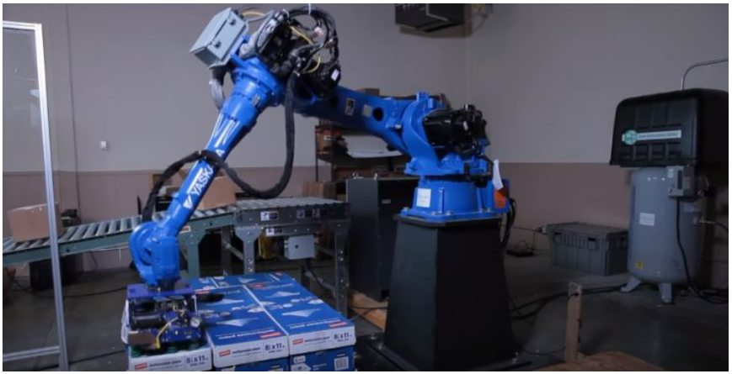
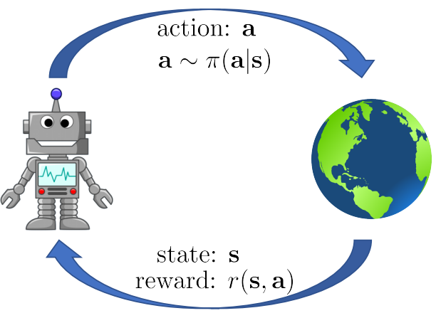
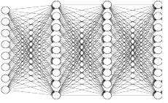
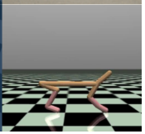
Background: What is RL?
RL = decision under uncertainty
RL models the natural learning-based control process.
The agent progressively improves its behavioral skills (policy) through iterative interactions with the environment and feedback in the form of rewards.

Slide 5
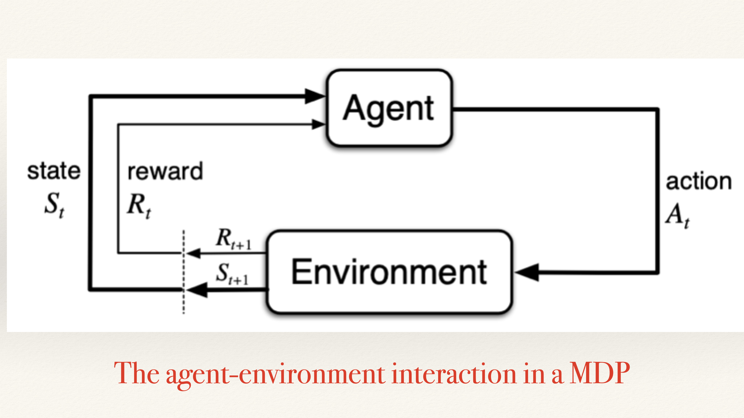

Slide 6
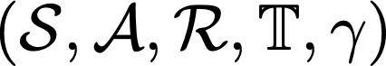
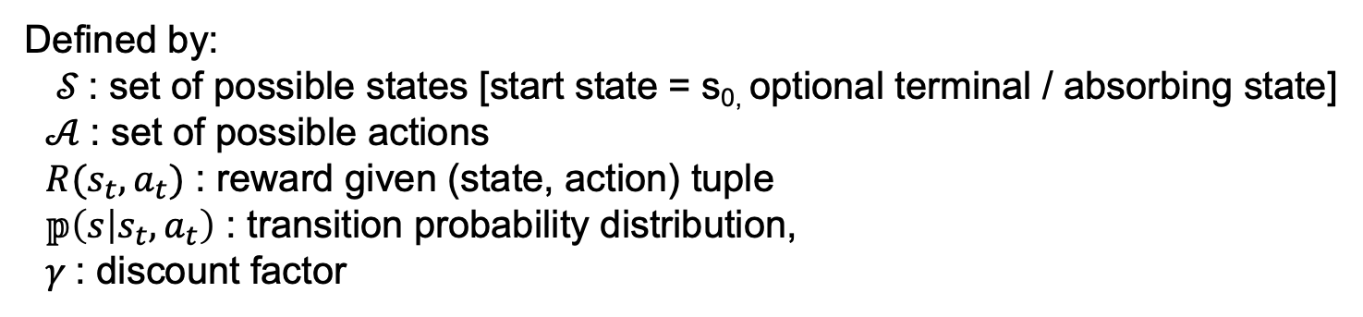
Markov Decision Process (MDP)
RL operates within a framework called Markov Decision Process
MDP’s: General formulation for decision making under uncertainty
Markov property: Current state completely characterizes state of the world
Defined by:
$𝒮$: set of possible states [start state = s_{0,} optional terminal / absorbing state]
$𝒜$: set of possible actions
$R(s_{t}, a_{t})$ : reward given (state, action) tuple
$𝕡\left(s | s_{t},a_{t}\right)$ : transition probability distribution,
$γ$: discount factor

Slide 7
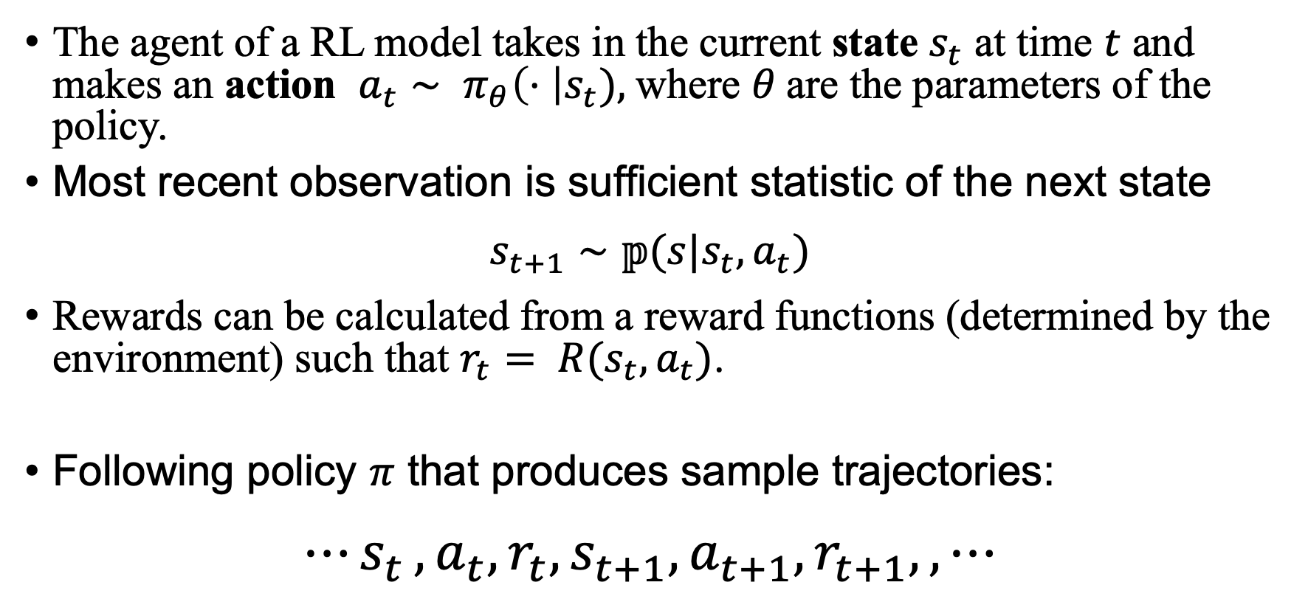
A RL Policy
The agent of a RL model takes in the current state $s_{t}$ at time $t$ and makes an action $a_{t}∼ π_{θ}\left(⋅ \right|s_{t}),$where $θ$are the parameters of the policy.
Most recent observation is sufficient statistic of the next state
$$s_{t+1}∼𝕡(s|s_{t},a_{t})$$
Rewards can be calculated from a reward functions (determined by the environment) such that $r_{t}= R(s_{t}, a_{t})$.
Following policy $π$ that produces sample trajectories:
$${⋯s}_{t},a_{t},r_{t},s_{t+1},a_{t+1},r_{t+1},,⋯$$

Slide 8
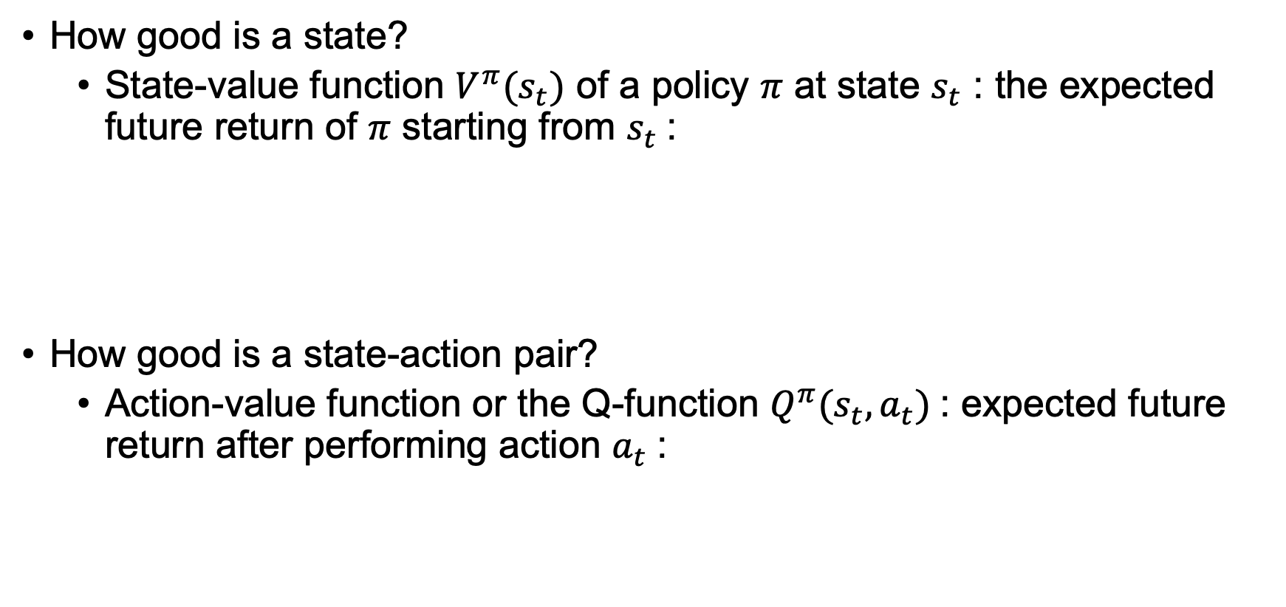
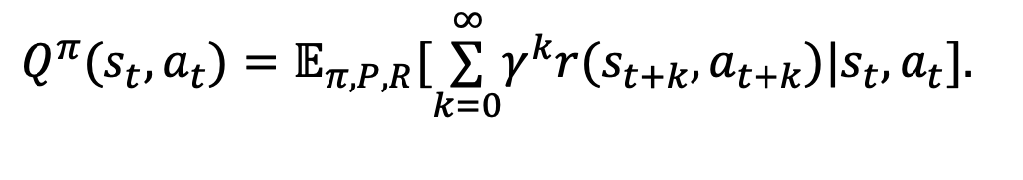
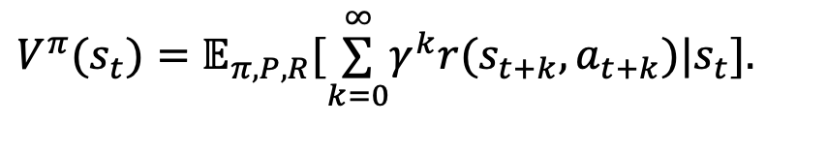
Value Function
How good is a state?
State-value function $V^{π}(s_{t})$ of a policy 𝜋 at state $s_{t}$ : the expected future return of 𝜋 starting from $s_{t}$:
How good is a state-action pair?
Action-value function or the Q-function $Q^{π}(s_{t},a_{t})$: expected future return after performing action $a_{t}$:
$$V^{π}(s_{t})=𝔼_{π,P,R}[\overset{∞}{\underset{k=0}{∑}}γ^{k}r(s_{t+k},a_{t+k})|s_{t}].$$
$$Q^{π}(s_{t},a_{t})=𝔼_{π,P,R}[\overset{∞}{\underset{k=0}{∑}}γ^{k}r(s_{t+k},a_{t+k})|s_{t},a_{t}].$$

Slide 9
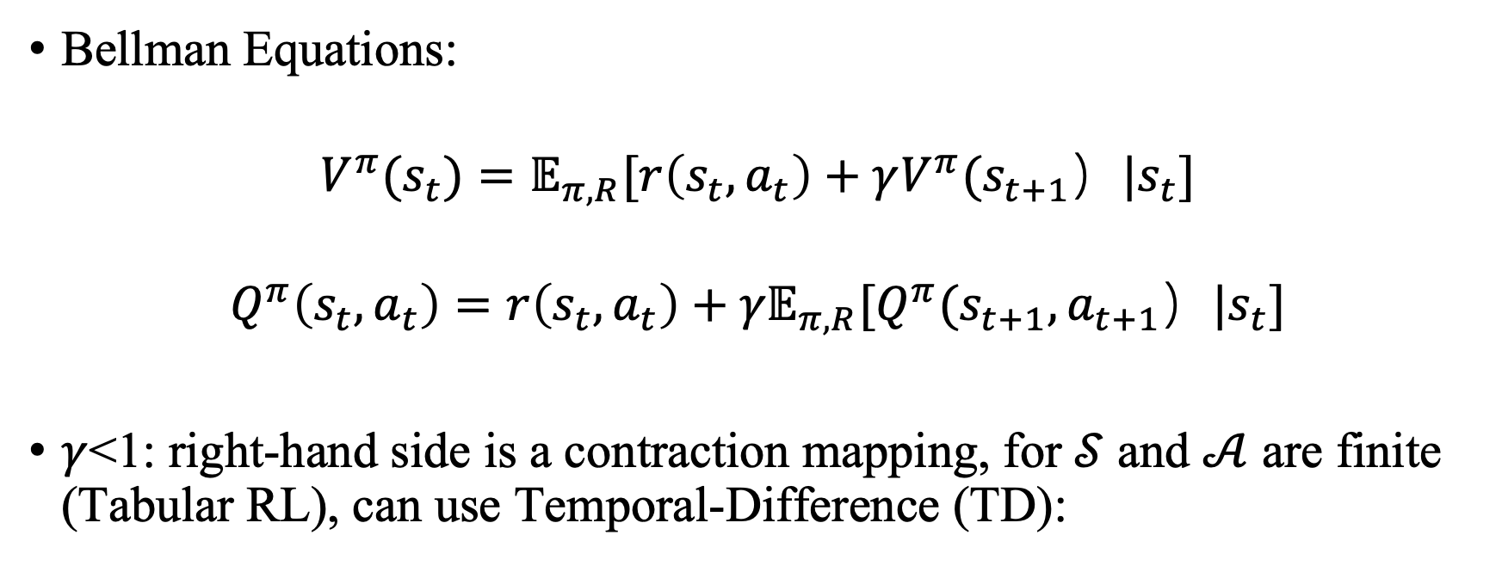
Bellman equations: fixed point
Bellman Equations:
$$V^{π}(s_{t})=𝔼_{π,R}[r\left(s_{t},a_{t}\right)+γV^{π}(s_{t+1}）|s_{t}]$$
$$Q^{π}\left(s_{t},a_{t}\right)=r\left(s_{t},a_{t}\right)+{γ𝔼}_{π,R}[Q^{π}(s_{t+1},a_{t+1}）|s_{t}]$$
$γ$<1: right-hand side is a contraction mapping, for $𝒮$ and $𝒜$ are finite (Tabular RL), can use Temporal-Difference (TD):
$$V^{π}\left(s_{t} \right)←V\left(s_{t} \right)+h_{t}[ r\left(s_{t},a_{t}\right)+γV^{π}\left(s_{t+1} \right)−V^{π}\left(s_{t} \right)]$$
$$Q^{π}\left(s_{t},a_{t}\right)←Q^{π}\left(s_{t},a_{t}\right)+h_{t}[ r\left(s_{t},a_{t}\right)+γQ^{π}\left(s_{t+1},a_{t+1}\right)−Q^{π}\left(s_{t},a_{t}\right)]$$

Slide 10
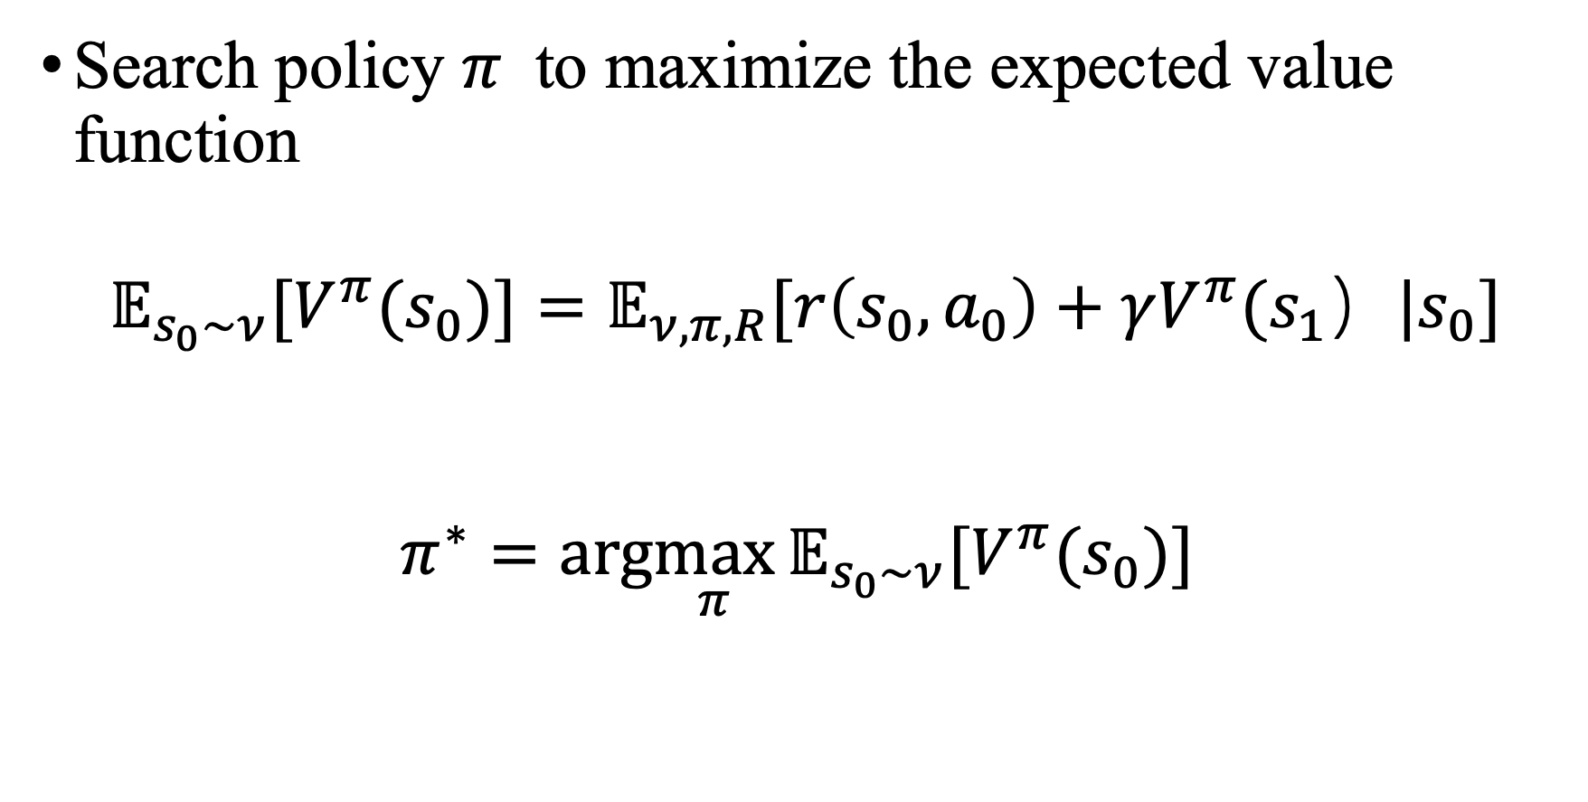
Objective
Search policy $π$ to maximize the expected value function
$${𝔼_{s_{0}∼ν}[V}^{π}(s_{0})]=𝔼_{ν,π,R}[r\left(s_{0},a_{0}\right)+γV^{π}(s_{1}）|s_{0}]$$
$$π^{∗}=arg\max_{π}{{𝔼_{s_{0}∼ν}[V}^{π}(s_{0})] }$$

Slide 11
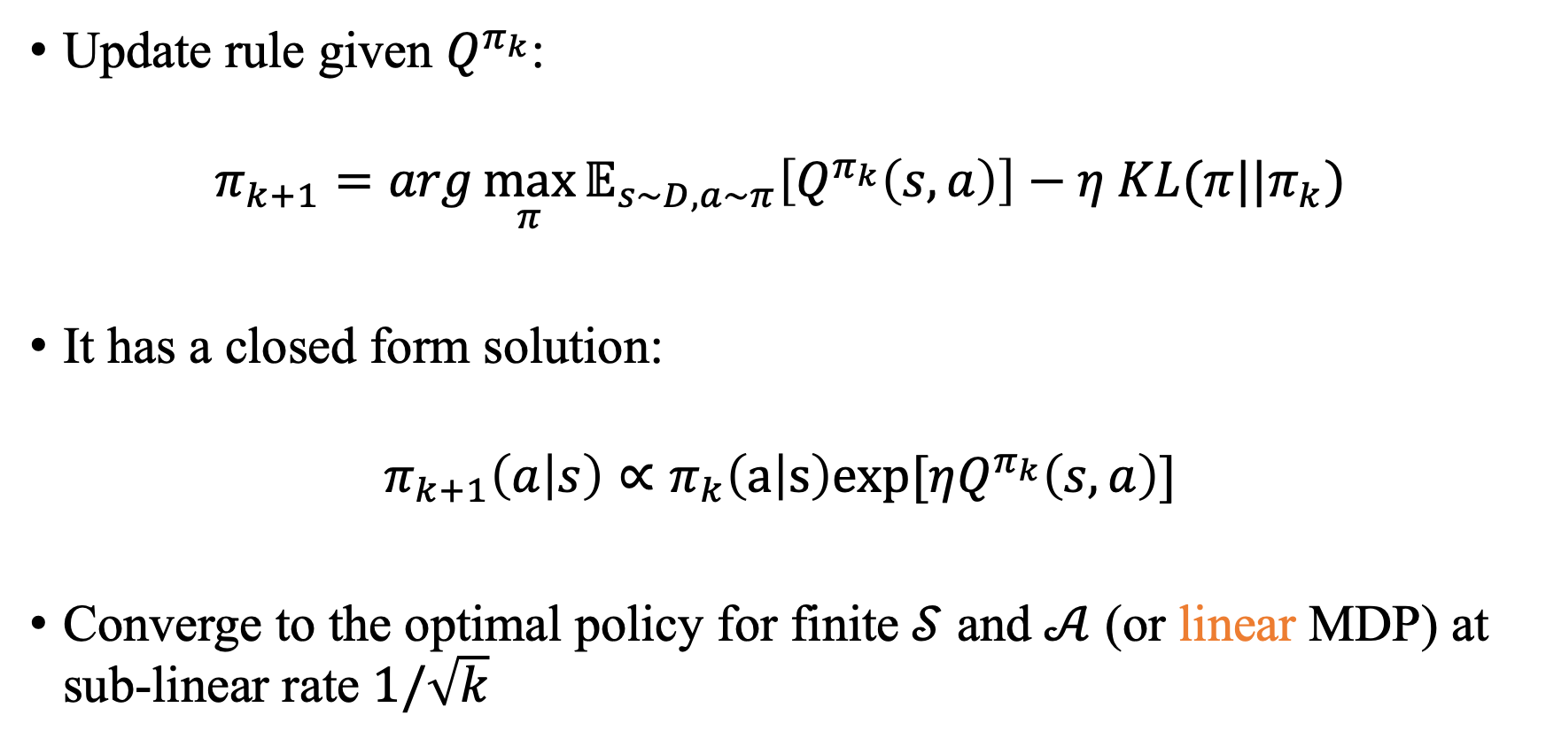
Proximal Policy Optimization
Update rule given $Q^{π_{k}}$:
$$π_{k+1}=arg\max_{π}{𝔼_{s∼D,a∼π}\left[Q^{π_{k}}\left(s,a\right)\right]−η KL(π||π_{k})}$$
It has a closed form solution:
$$π_{k+1}\left(a | s\right)∝π_{k}\left(a | s\right)exp[ηQ^{π_{k}}\left(s,a\right)]$$
Converge to the optimal policy for finite $𝒮$ and $𝒜$ (or linear MDP) at sub-linear rate $1/\sqrt{k}$

Slide 12
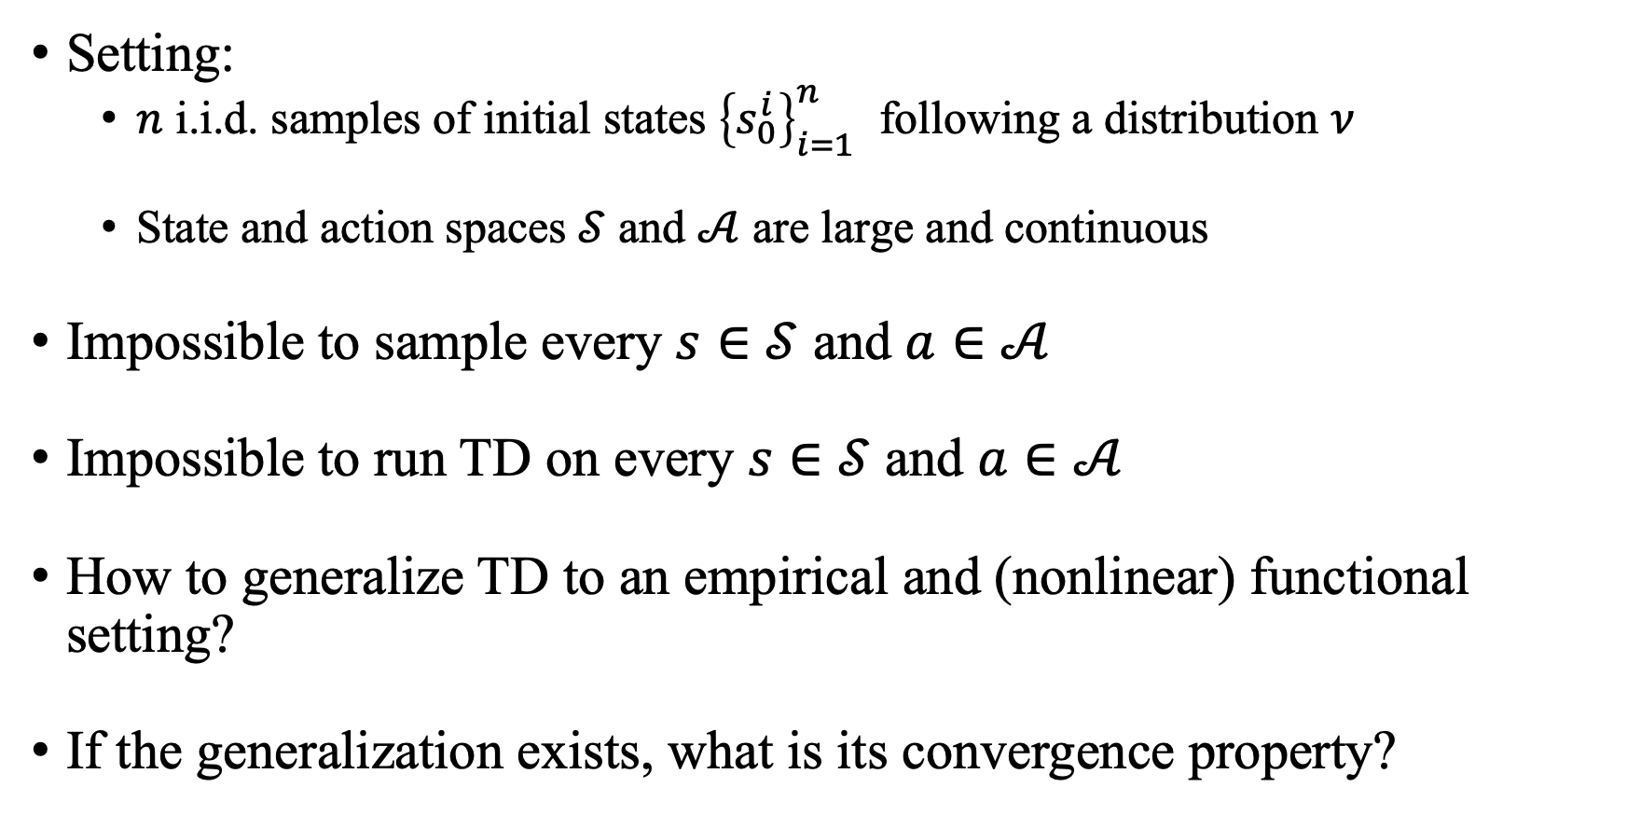
Problem
Setting:
$n$ i.i.d. samples of initial states ${\left\{s_{0}^{i}\right\}}_{i=1}^{n}$ following a distribution $ν$
State and action spaces $𝒮$ and $𝒜$ are large and continuous
Impossible to sample every $s∈𝒮$ and $a∈𝒜$
Impossible to run TD on every $s∈𝒮$ and $a∈𝒜$
How to generalize TD to an empirical and (nonlinear) functional setting?
If the generalization exists, what is its convergence property?

Slide 13
Content
Background
Reproducing Kernel Hilbert Space (RKHS)
Proximal Policy Optimization
Numerical Experiments

Slide 14
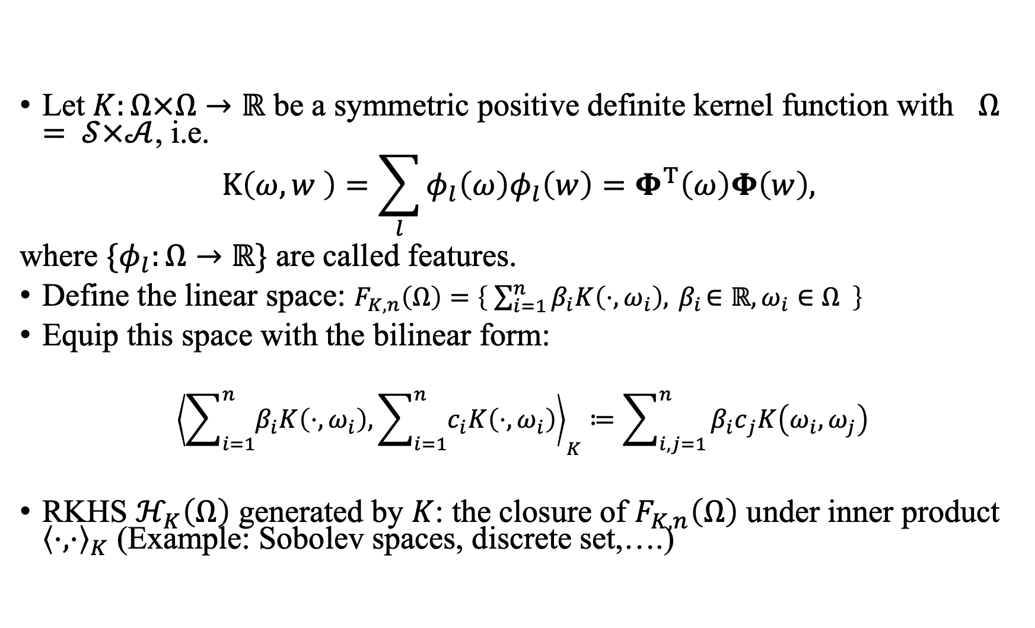
Kernel Function
Let $K:Ω×Ω→ℝ$ be a symmetric positive definite kernel function with $Ω= 𝒮×𝒜$, i.e.
$$K\left(ω,w \right)=\sum_{l}{φ_{l}\left(ω\right)φ_{l}\left(w\right)=Φ^{T}\left(ω\right)Φ\left(w\right),}$$
where ${\{φ}_{l}:Ω→ℝ\}$ are called features.
Define the linear space: $F_{K,n}\left(Ω\right)=\left\{ \sum_{i=1}^{n}{β_{i}K\left(⋅, ω_{i}\right),}{ β}_{i}∈ℝ, ω_{i}∈Ω \right\}$
Equip this space with the bilinear form:
$${\left\langle \sum_{i=1}^{n}{β_{i}K\left(⋅, ω_{i}\right),}\sum_{i=1}^{n}{c_{i}K\left(⋅, ω_{i}\right)}\right\rangle }_{K}≔\sum_{i,j=1}^{n}{{β_{i}c}_{j}K\left(ω_{i}, ω_{j}\right)}$$
RKHS $ℋ_{K}\left(Ω\right)$ generated by $K$: the closure of $F_{K,n}\left(Ω\right)$ under inner product ${\left\langle ⋅,⋅\right\rangle }_{K}$ (Example: Sobolev spaces, discrete set,….)

Slide 15
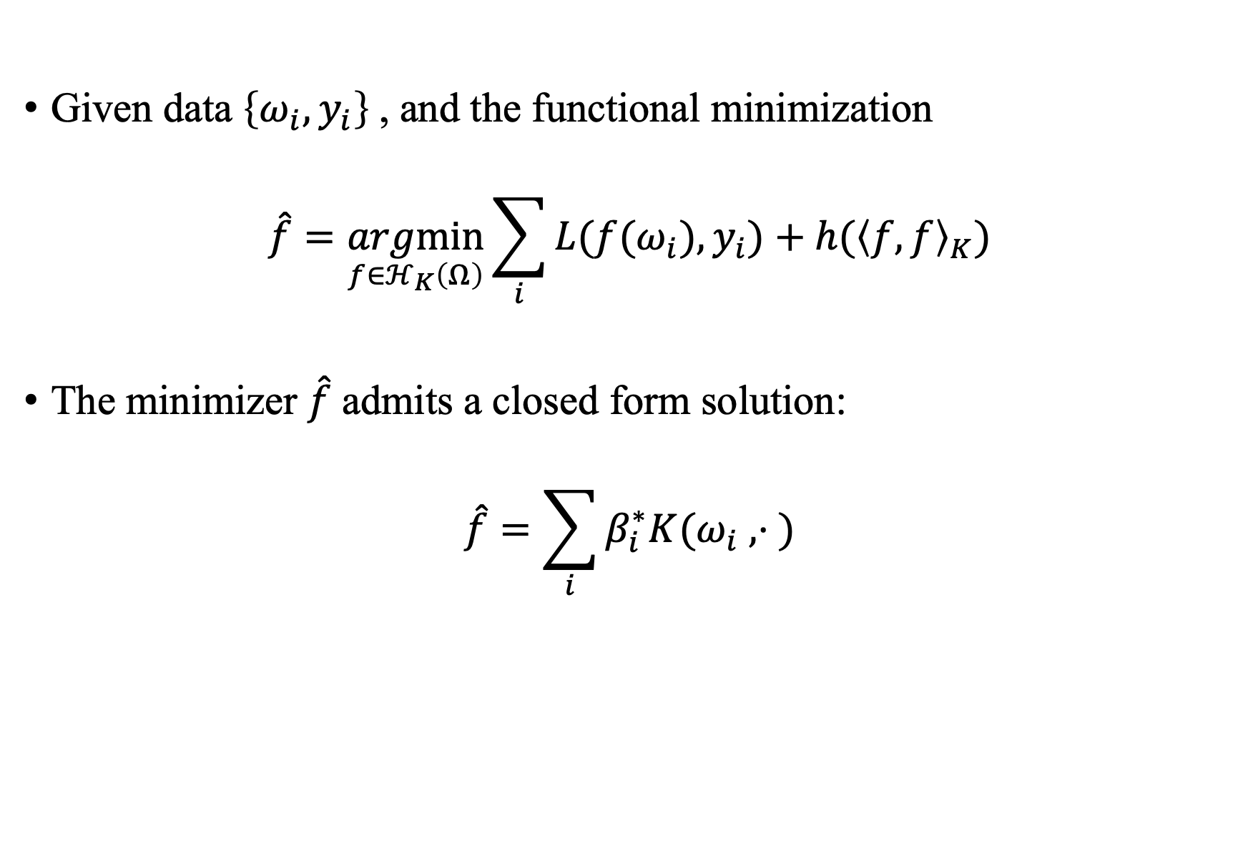
Representer Theorem
Given data $\left\{ω_{i}, y_{i}\right\}$, and the functional minimization
$$\hat{f}=\underset{f∈ℋ_{K}\left(Ω\right)}{argmin}{\sum_{i}{L({f(ω}_{i}),y_{i})+h({\left\langle f,f\right\rangle }_{K})}}$$
The minimizer $\hat{f}$ admits a closed form solution:
$$\hat{f}=\sum_{i}{β_{i}^{∗}K(ω_{i} , ⋅ )}$$

Slide 16
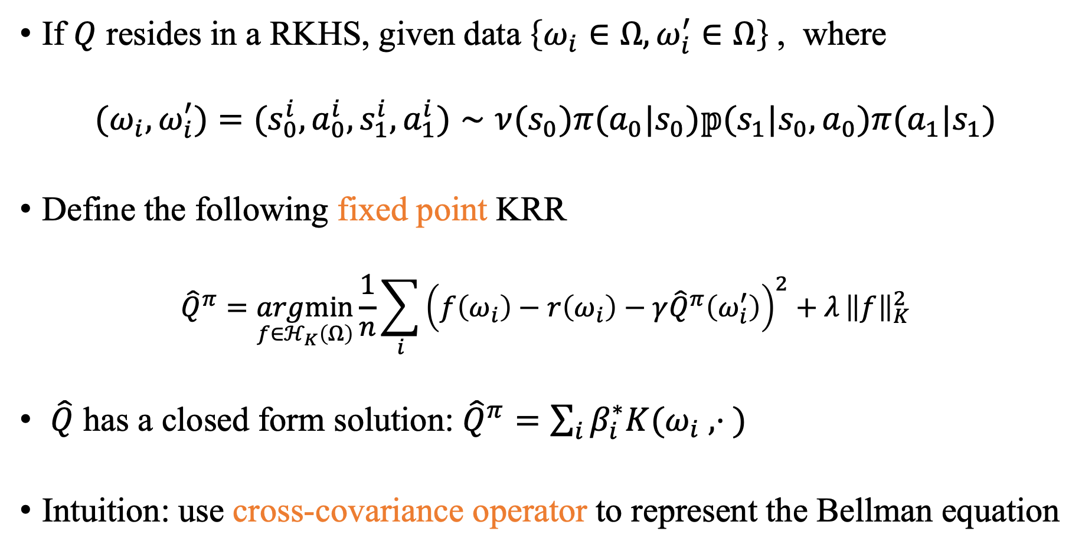
Representer Theorem for Bellman Equation
If $Q$ resides in a RKHS, given data $\left\{ω_{i}∈Ω, ω_{i}^{′}∈Ω\right\}$, where
$${(ω}_{i},ω_{i}^{′})={(s}_{0}^{i},a_{0}^{i},s_{1}^{i},a_{1}^{i})∼ν(s_{0})π(a_{0}|s_{0})𝕡(s_{1}|s_{0},a_{0})π(a_{1}|s_{1})$$
Define the following fixed point KRR
$${\hat{Q}}^{π}=\underset{f∈ℋ_{K}\left(Ω\right)}{argmin}{\frac{1}{n}\sum_{i}{{\left(f\left(ω_{i}\right)−r\left(ω_{i}\right)−γ{\hat{Q}}^{π}\left(ω_{i}^{′}\right)\right)}^{2}+λ}}{\left\|f\right\|}_{K}^{2}$$
$\hat{Q}$ has a closed form solution: ${\hat{Q}}^{π}=\sum_{i}{β_{i}^{∗}K(ω_{i} , ⋅ )}$
Intuition: use cross-covariance operator to represent the Bellman equation

Slide 17
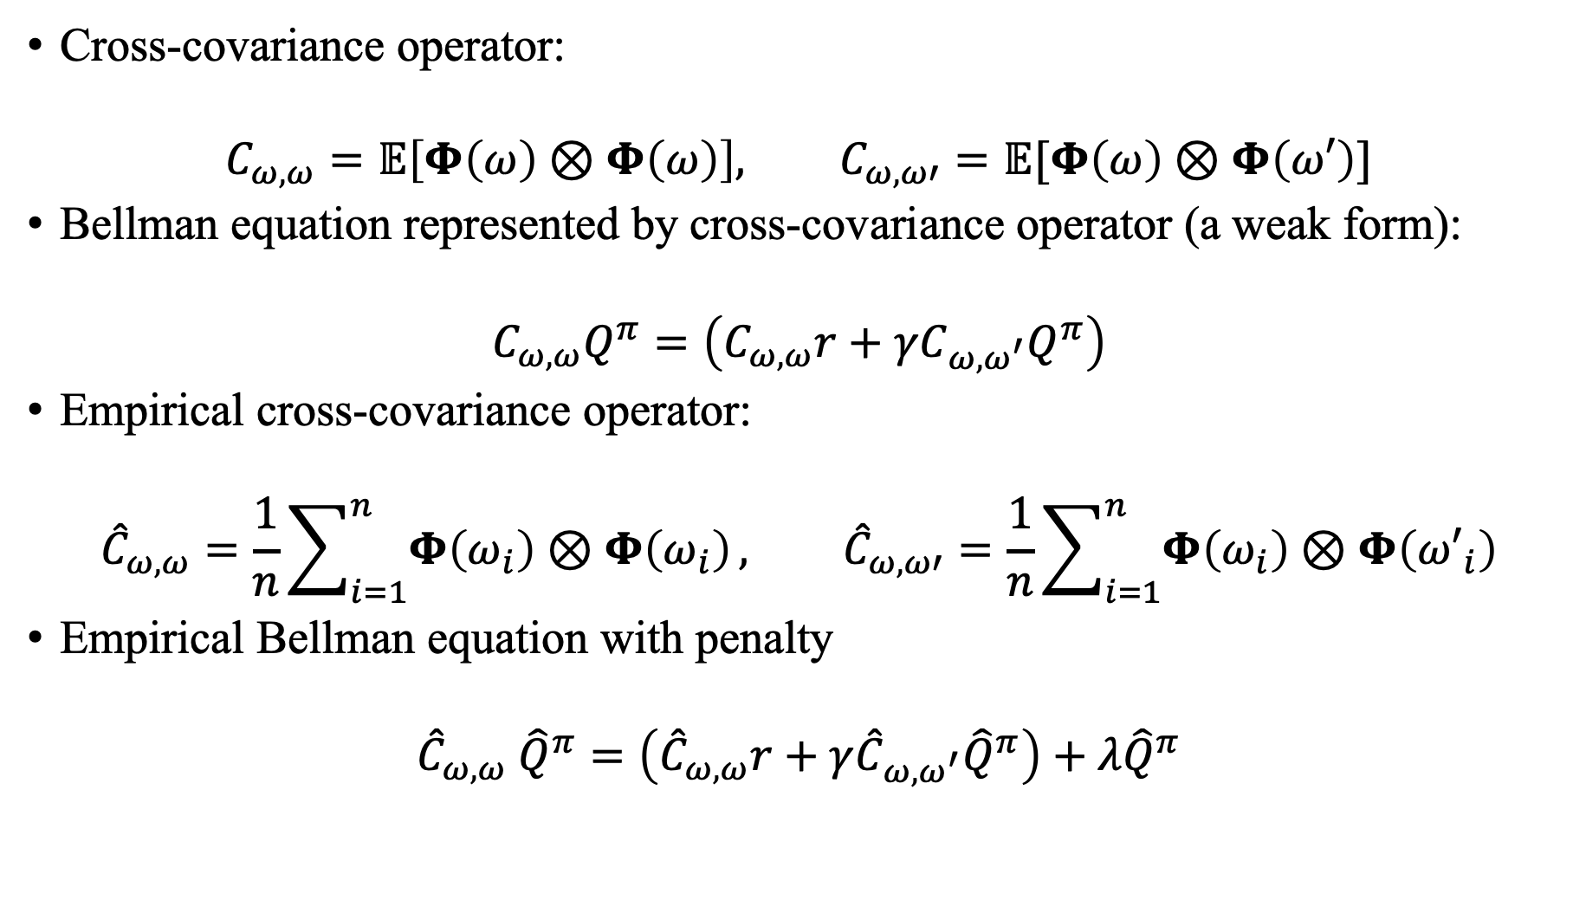
Representer Theorem for Bellman Equation
Cross-covariance operator:
$$C_{ω,ω}=𝔼\left[Φ\left(ω\right)⊗Φ\left(ω\right)\right], C_{ω,ω′}=𝔼[Φ\left(ω\right)⊗Φ\left(ω′\right)]$$
Bellman equation represented by cross-covariance operator (a weak form):
$$C_{ω,ω}Q^{π}=\left(C_{ω,ω}r+γC_{ω,ω^{′}}Q^{π}\right)$$
Empirical cross-covariance operator:
$${\hat{C}}_{ω,ω}=\frac{1}{n}\sum_{i=1}^{n}{Φ\left(ω_{i}\right)⊗Φ\left(ω_{i}\right)}, {\hat{C}}_{ω,ω′}=\frac{1}{n}\sum_{i=1}^{n}{Φ\left(ω_{i}\right)⊗Φ\left({ω′}_{i}\right)}$$
Empirical Bellman equation with penalty
$${\hat{C}}_{ω,ω} {\hat{Q}}^{π}=\left({\hat{C}}_{ω,ω}r+γ{\hat{C}}_{ω,ω^{′}}{\hat{Q}}^{π}\right)+λ{\hat{Q}}^{π}$$

Slide 18
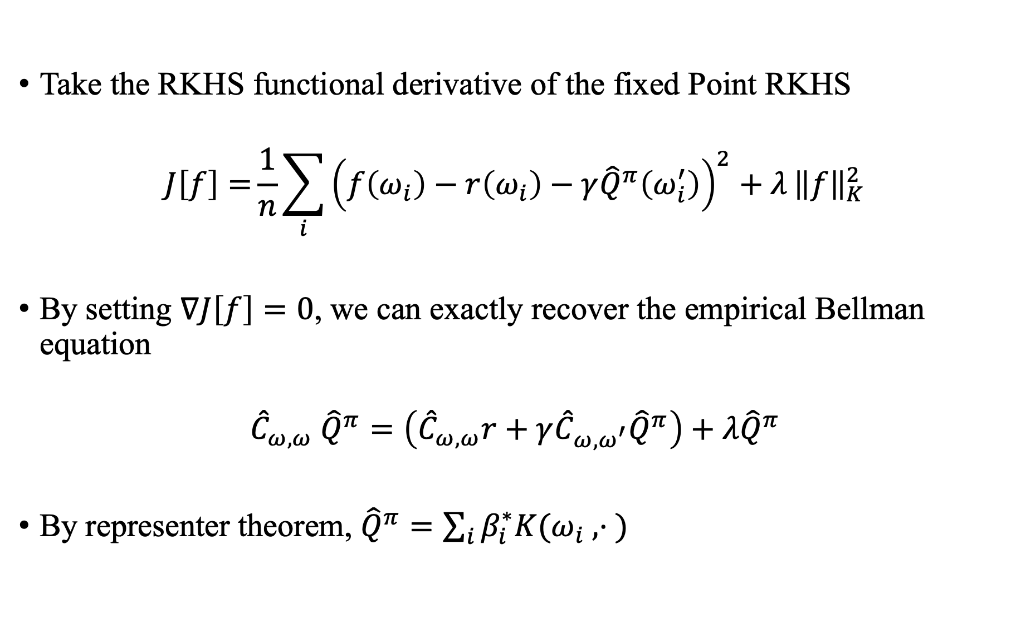
Representer Theorem for Bellman Equation
Take the RKHS functional derivative of the fixed Point RKHS
$$J\left[f\right]={\frac{1}{n}\sum_{i}{{\left(f\left(ω_{i}\right)−r\left(ω_{i}\right)−γ{\hat{Q}}^{π}\left(ω_{i}^{′}\right)\right)}^{2}+λ}}{\left\|f\right\|}_{K}^{2}$$
By setting $∇J\left[f\right]=0$, we can exactly recover the empirical Bellman equation
$${\hat{C}}_{ω,ω} {\hat{Q}}^{π}=\left({\hat{C}}_{ω,ω}r+γ{\hat{C}}_{ω,ω^{′}}{\hat{Q}}^{π}\right)+λ{\hat{Q}}^{π}$$
By representer theorem, ${\hat{Q}}^{π}=\sum_{i}{β_{i}^{∗}K(ω_{i} , ⋅ )}$

Slide 19
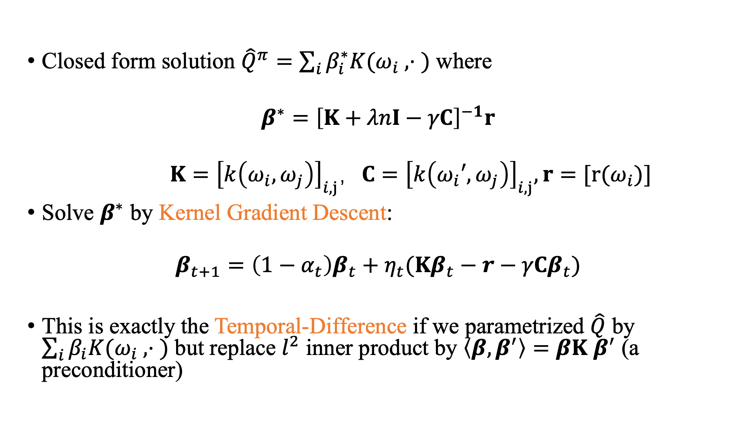
Kernel Gradient Descent
Closed form solution ${\hat{Q}}^{π}=\sum_{i}{β_{i}^{∗}K(ω_{i} , ⋅ )}$ where
$$β^{∗}={\left[K+λnI−γC\right]}^{−1}r$$
$$K={\left[k\left(ω_{i},ω_{j}\right)\right]}_{i,j}，C={\left[k\left(ω_{i}′,ω_{j}\right)\right]}_{i,j},r=[r(ω_{i})]$$
Solve $β^{∗}$ by Kernel Gradient Descent:
$$β_{t+1}=\left(1−α_{t}\right)β_{t}+η_{t}(Kβ_{t}−r−γCβ_{t})$$
This is exactly the Temporal-Difference if we parametrized $\hat{Q}$ by $\sum_{i}{β_{i}K(ω_{i} , ⋅ )}$ but replace $l^{2}$ inner product by $\left\langle β,β^{′}\right\rangle =βK$ $β^{′}$ (a preconditioner)

Slide 20
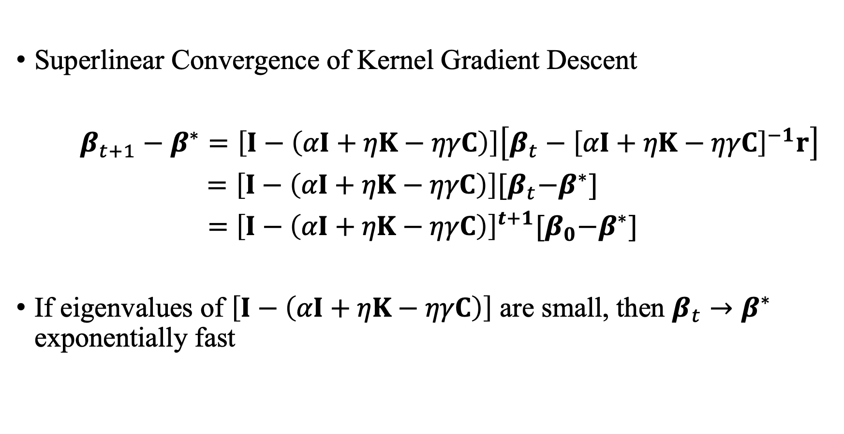
Kernel Gradient Descent
Superlinear Convergence of Kernel Gradient Descent
$β_{t+1}−β^{∗}=\left[I−\left(αI+ηK−ηγC\right)\right]\left[β_{t}−{\left[αI+ηK−ηγC\right]}^{−1}r\right]$
$=\left[I−\left(αI+ηK−ηγC\right)\right]{[β}_{t}−β^{∗}]$
= ${\left[I−\left(αI+ηK−ηγC\right)\right]}^{t+1}{[β}_{0}−β^{∗}]$
If eigenvalues of $\left[I−\left(αI+ηK−ηγC\right)\right]$ are small, then $β_{t}→β^{∗}$ exponentially fast

Slide 21
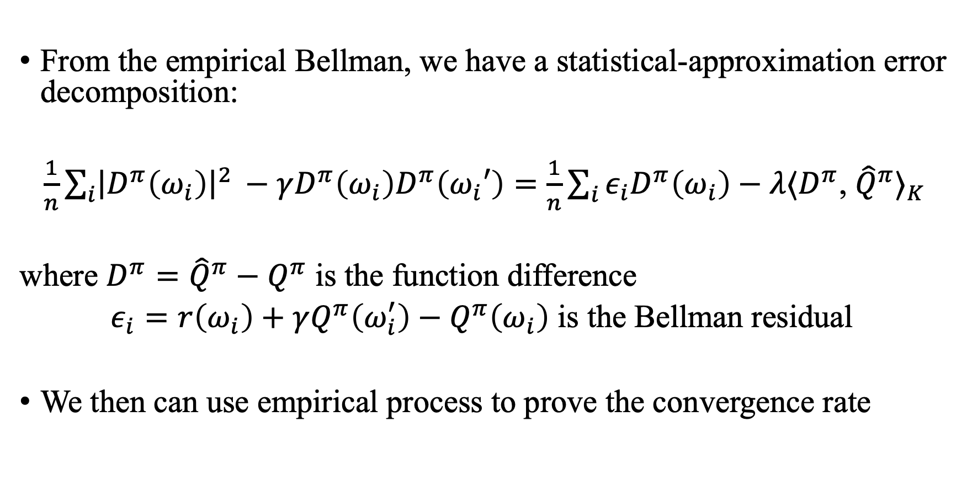
Convergence Analysis
From the empirical Bellman, we have a statistical-approximation error decomposition:
$\frac{1}{n}\sum_{i}{{\left.​\right|D}^{π}\left(ω_{i}\right){\left.​\right|}^{2 }−γD^{π}\left(ω_{i}\right)D^{π}\left(ω_{i}′\right)=\frac{1}{n}\sum_{i}{ε_{i}D^{π}\left(ω_{i}\right)−λ⟨D^{π}}}$, ${\hat{Q}}^{π}⟩_{K}$
where $D^{π}={\hat{Q}}^{π}−Q^{π}$ is the function difference
$ε_{i}=r\left(ω_{i}\right)+γQ^{π}\left(ω_{i}^{′}\right)−Q^{π}\left(ω_{i}\right)$ is the Bellman residual
We then can use empirical process to prove the convergence rate

Slide 22
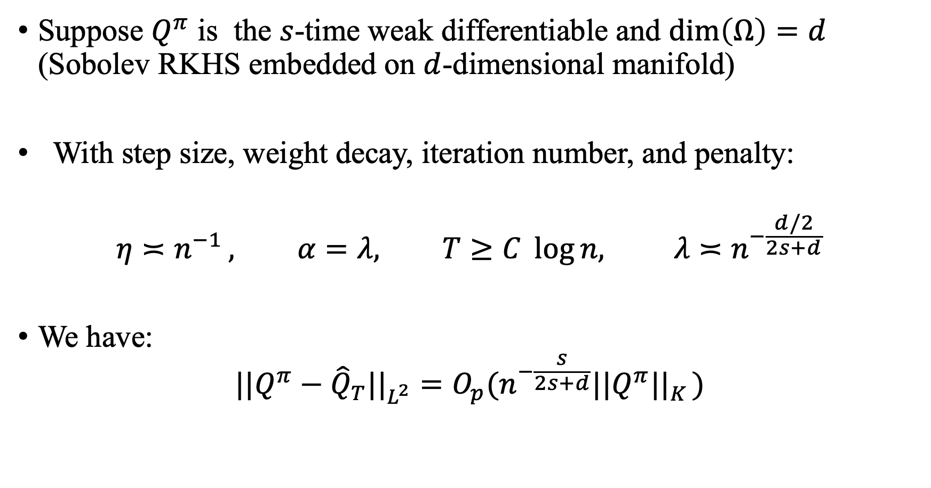
Convergence Analysis (Sobolev)
Suppose $Q^{π}$ is the $s$-time weak differentiable and $dim\left(Ω\right)=d$ (Sobolev RKHS embedded on $d$-dimensional manifold)
With step size, weight decay, iteration number, and penalty:
$$η≍n^{−1 }, α=λ, T≥C \log{n, λ≍n^{−\frac{d/2}{2s+d}}}$$
We have:
$$||Q^{π}−{\hat{Q}}_{T}||_{L^{2}}^{}=O_{p}(n^{−\frac{s}{2s+d}}||Q^{π}||_{K}^{})$$

Slide 23
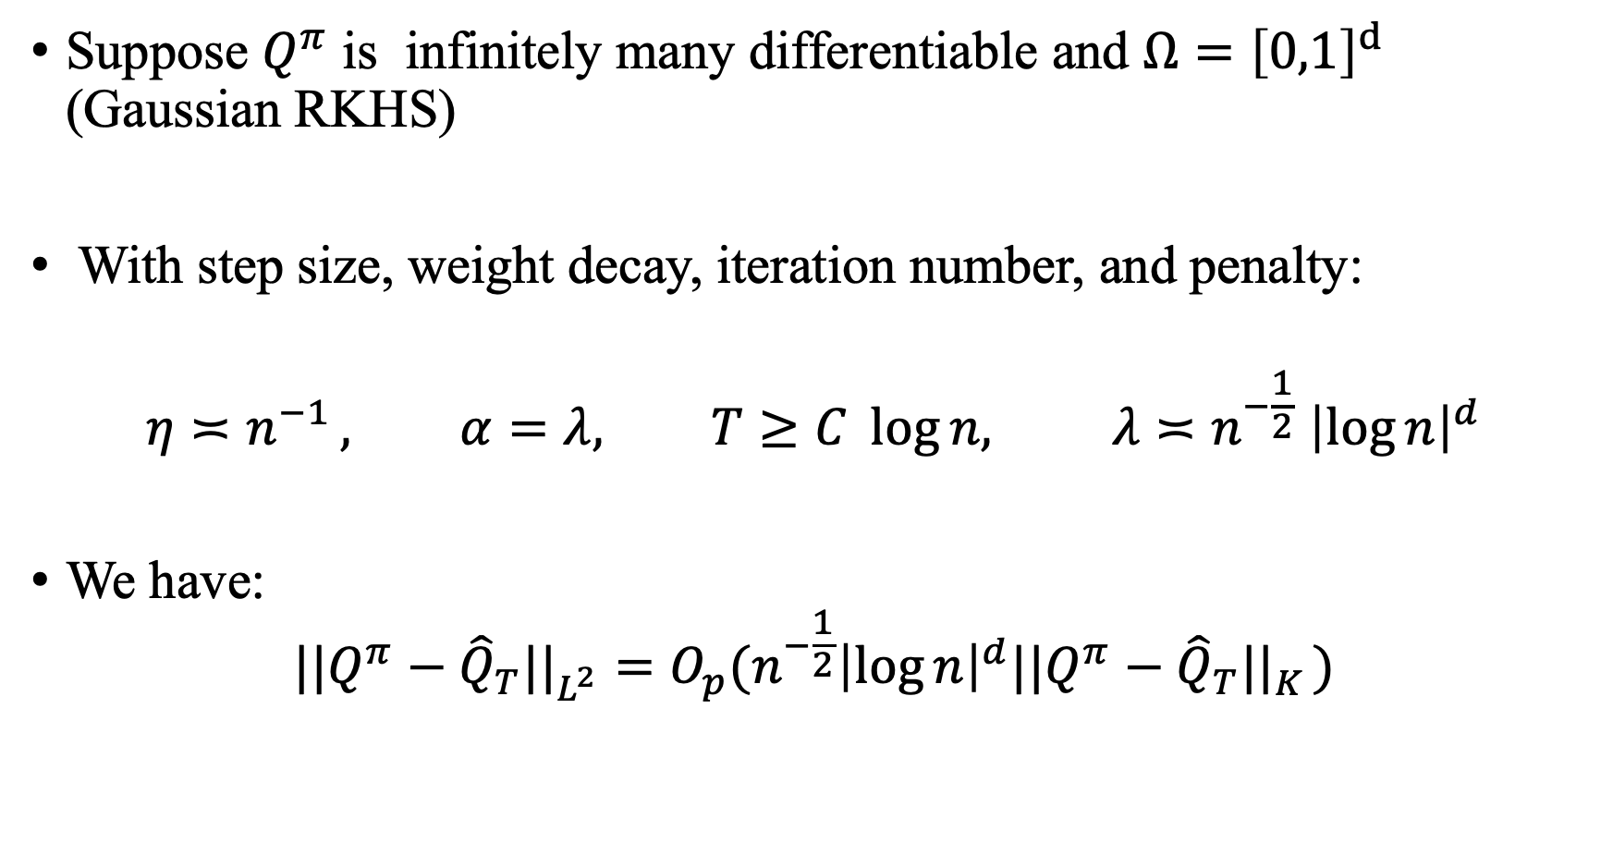
Convergence Analysis (Gaussian)
Suppose $Q^{π}$ is infinitely many differentiable and $Ω={\left[0,1\right]}^{d}$ (Gaussian RKHS)
With step size, weight decay, iteration number, and penalty:
$$η≍n^{−1 }, α=λ, T≥C \log{n, λ≍n^{−\frac{1}{2}} {\left|\log{n}\right|}^{d}}$$
We have:
$$||Q^{π}−{\hat{Q}}_{T}||_{L^{2}}^{}=O_{p}(n^{−\frac{1}{2}}{\left|\log{n}\right|}^{d}||Q^{π}−{\hat{Q}}_{T}||_{K}^{})$$

Slide 24
Content
Background
Offline Reinforcement Learning
Proximal Policy Optimization
Numerical Experiments

Slide 25
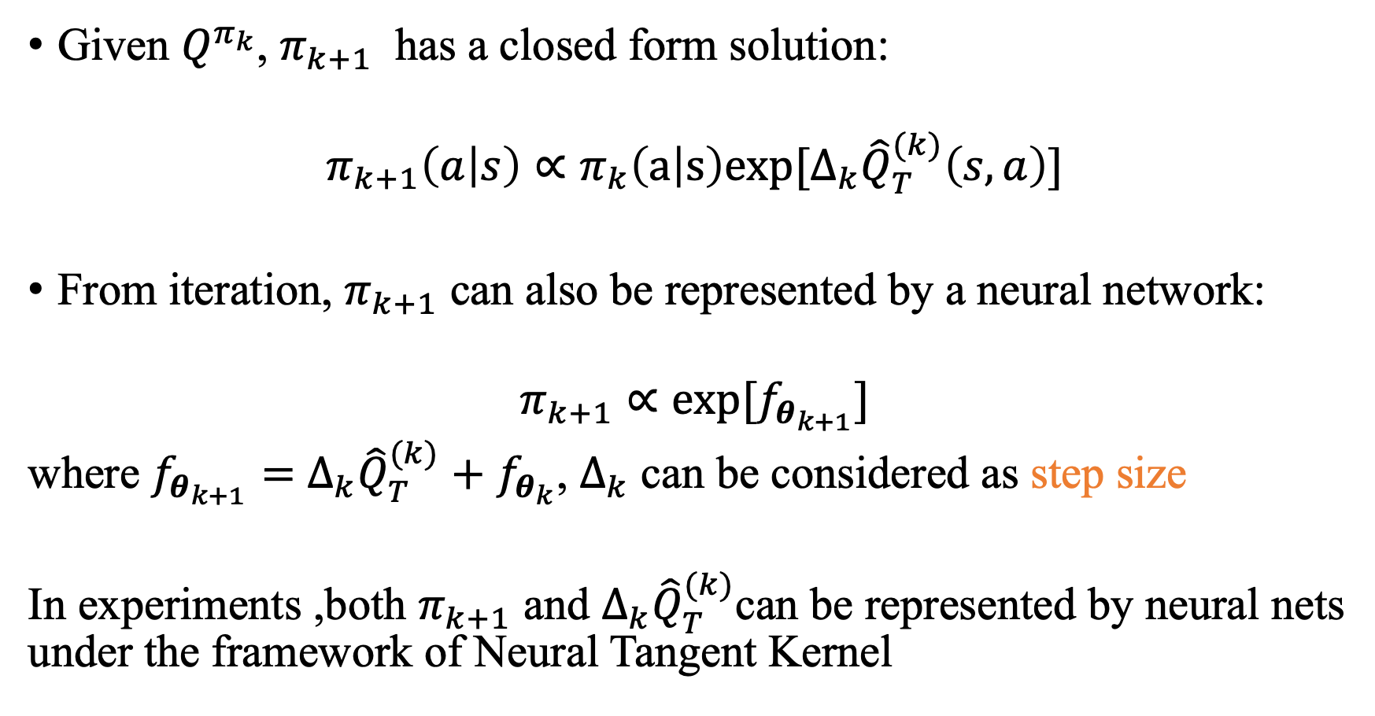
Policy Update
Given $Q^{π_{k}}$, $π_{k+1}$ has a closed form solution:
$$π_{k+1}\left(a | s\right)∝π_{k}\left(a | s\right)exp[Δ_{k}{\hat{Q}}_{T}^{(k)}\left(s,a\right)]$$
From iteration, $π_{k+1}$ can also be represented by a neural network:
$$π_{k+1}∝exp[f_{θ_{k+1}}]$$
where $f_{θ_{k+1}}=$ $Δ_{k}{\hat{Q}}_{T}^{(k)}+$ $f_{θ_{k}}$, $Δ_{k}$ can be considered as step size
In experiments ,both $π_{k+1}$ and $Δ_{k}{\hat{Q}}_{T}^{(k)}$can be represented by neural nets under the framework of Neural Tangent Kernel

Slide 26
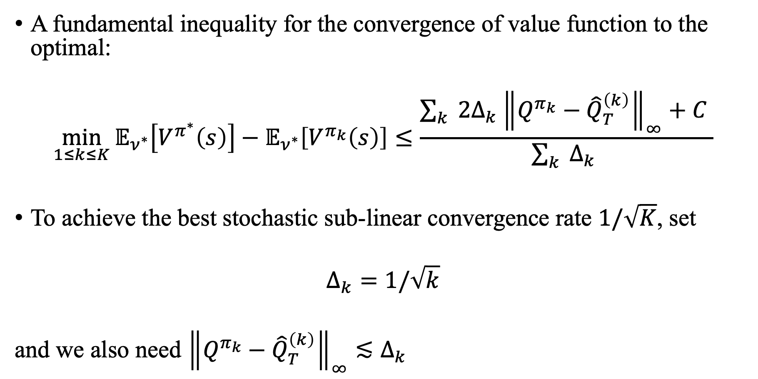
A Fundamental Inequality
A fundamental inequality for the convergence of value function to the optimal:
$$\min_{1≤k≤K}{{𝔼_{ν^{∗}}\left[V^{π^{∗}}\left(s\right)\right]−𝔼}_{ν^{∗}}\left[V^{π_{k}}\left(s\right)\right]}≤\frac{\sum_{k}{ {2Δ}_{k}{\left\|Q^{π_{k}}−{\hat{Q}}_{T}^{\left(k\right)}\right\|}_{∞}+C }}{\sum_{k}{ Δ_{k} }}$$
To achieve the best stochastic sub-linear convergence rate $1/\sqrt{K}$, set
$$Δ_{k}=1/\sqrt{k}$$
and we also need ${\left\|Q^{π_{k}}−{\hat{Q}}_{T}^{\left(k\right)}\right\|}_{∞}≲Δ_{k}$

Slide 27
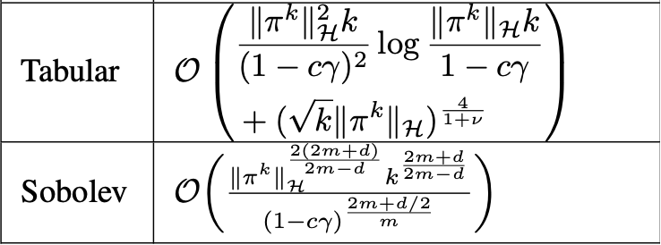
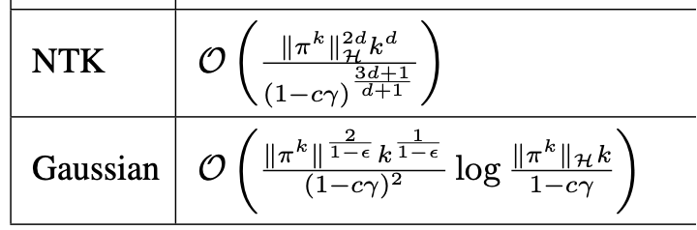
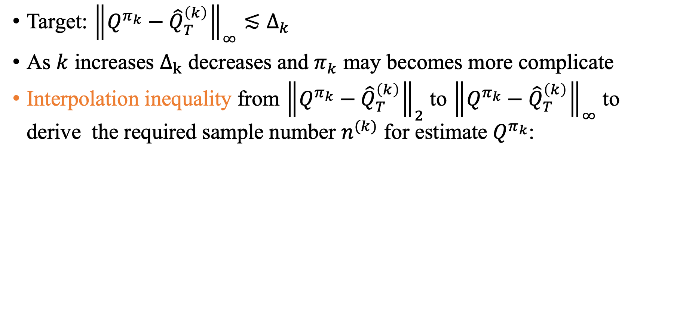
Sampling Requirement
Target: ${\left\|Q^{π_{k}}−{\hat{Q}}_{T}^{\left(k\right)}\right\|}_{∞}≲Δ_{k}$
As $k$ increases $Δ_{k}$ decreases and $π_{k}$ may becomes more complicate
Interpolation inequality from ${\left\|Q^{π_{k}}−{\hat{Q}}_{T}^{\left(k\right)}\right\|}_{2}$ to ${\left\|Q^{π_{k}}−{\hat{Q}}_{T}^{\left(k\right)}\right\|}_{∞}$ to derive the required sample number $n^{(k)}$ for estimate $Q^{π_{k}}$:

Slide 28
Content
Background
Offline Reinforcement Learning
Proximal Policy Optimization
Numerical Experiments

Slide 29
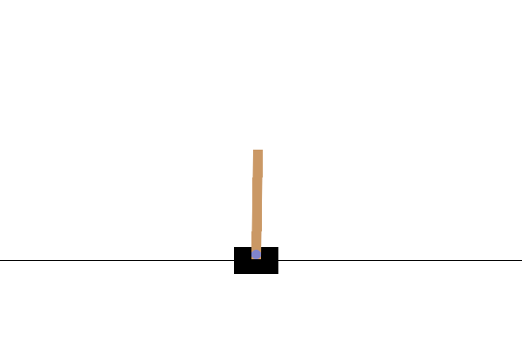
Cart Pole
Action Space: 2 discrete actions
0: Push cart to the left
1: Push cart to the right
Goal: to keep the pole upright for as long as possible.
Observation Space/State Space: 4 continuous variables
Num | Observation | Min | Max
0 | Cart Position | -4.8 | 4.8
1 | Cart Velocity | -Inf | Inf
2 | Pole Angle | ~ -0.418 rad (-24°) | ~ 0.418 rad (24°)
3 | Pole Angular Velocity | -Inf | Inf
https://gymnasium.farama.org/environments/classic_control/cart_pole/
Rewards: Since, by default, a reward of +1 is given for every step taken, including the termination step. The default reward threshold is 500.
Q network: 3 layers deep neural network
state dim (4) → hidden dim (64) → hidden dim (64) → action dim (2)
.
.
.
.
.
.

Slide 30
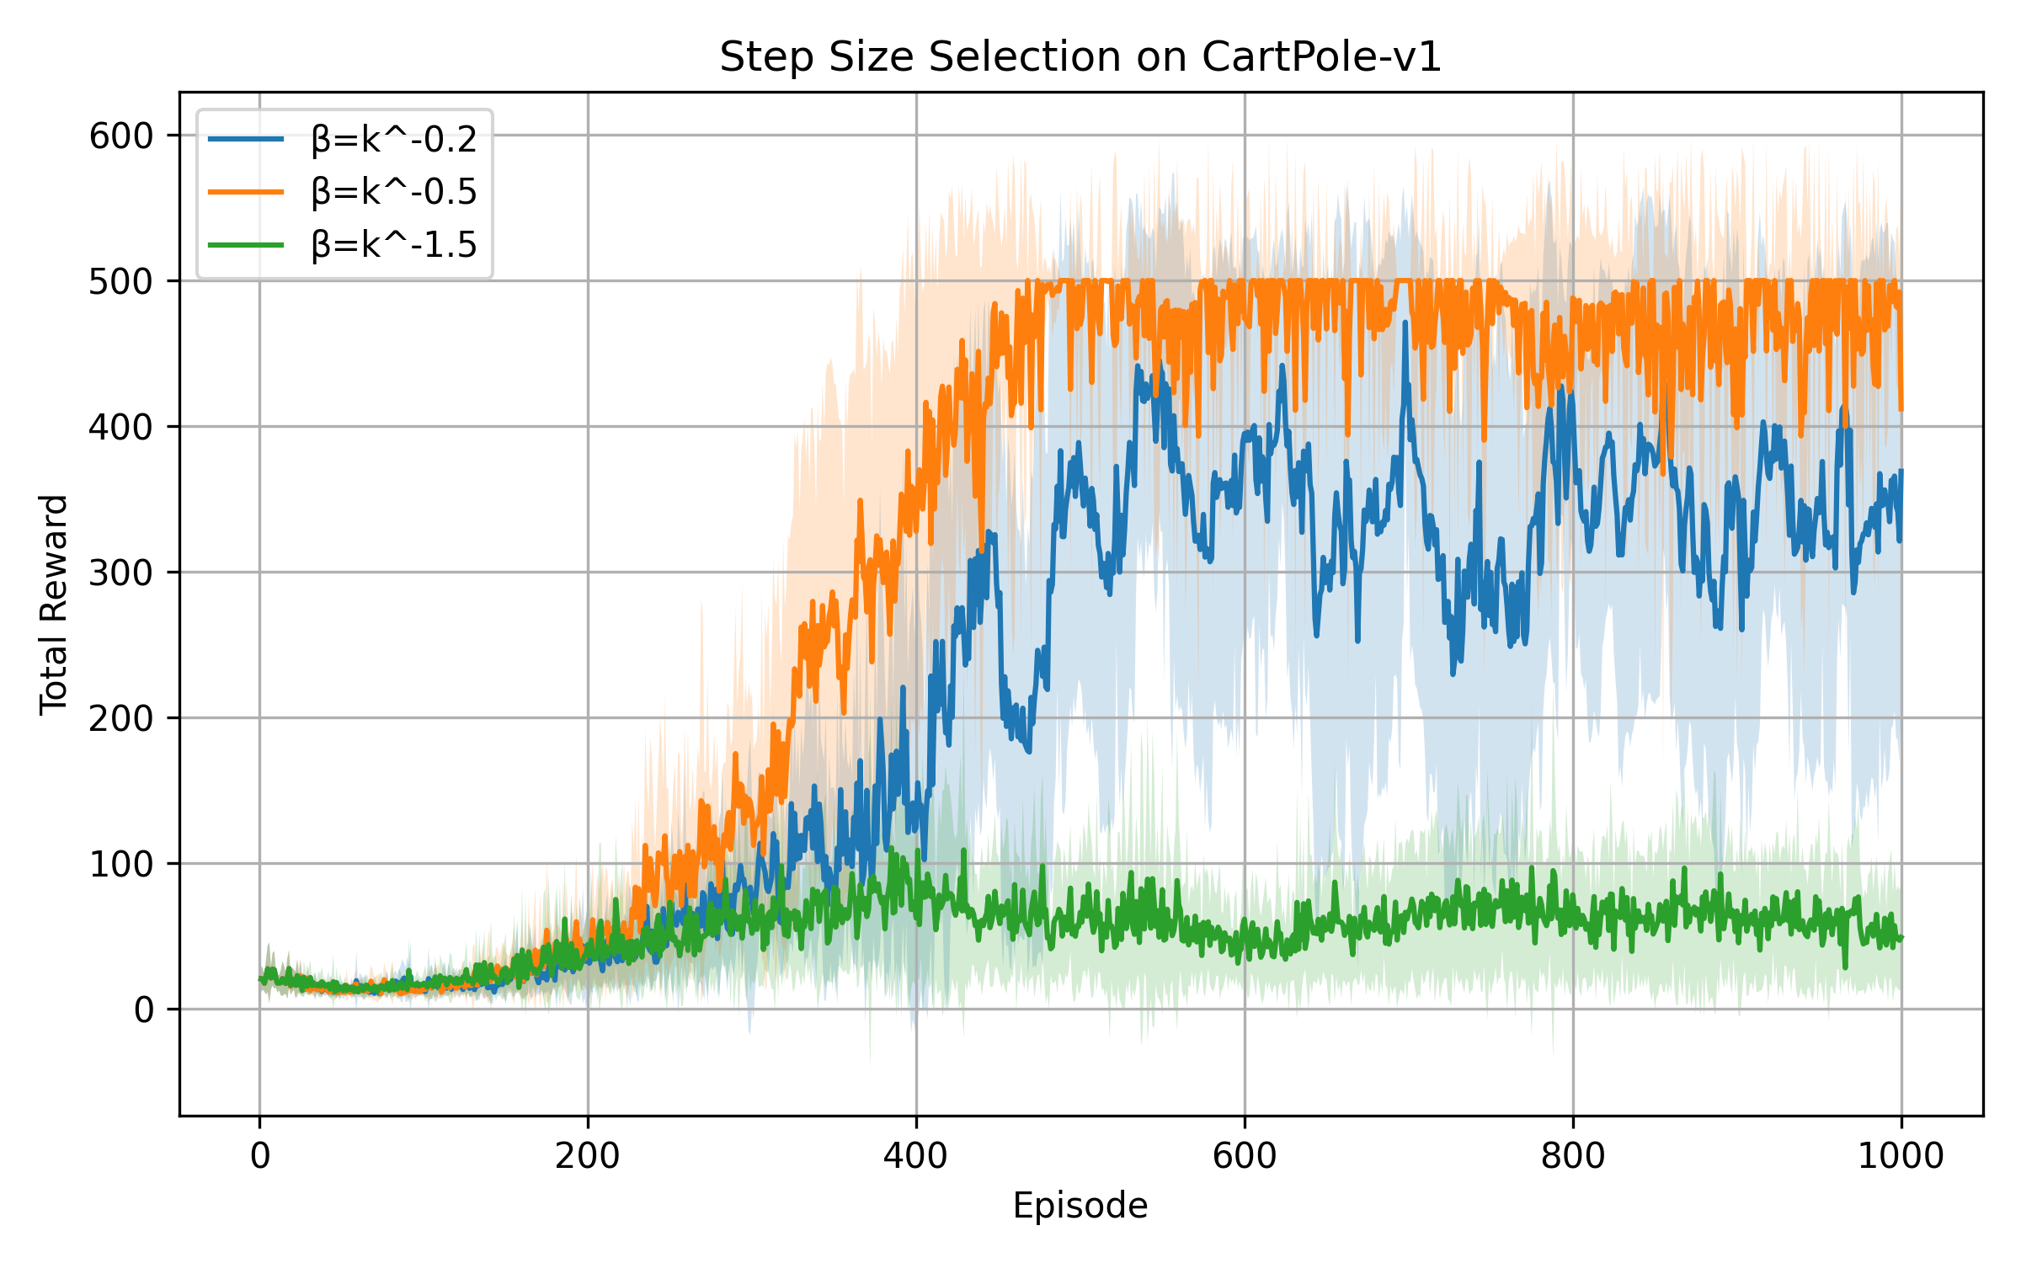
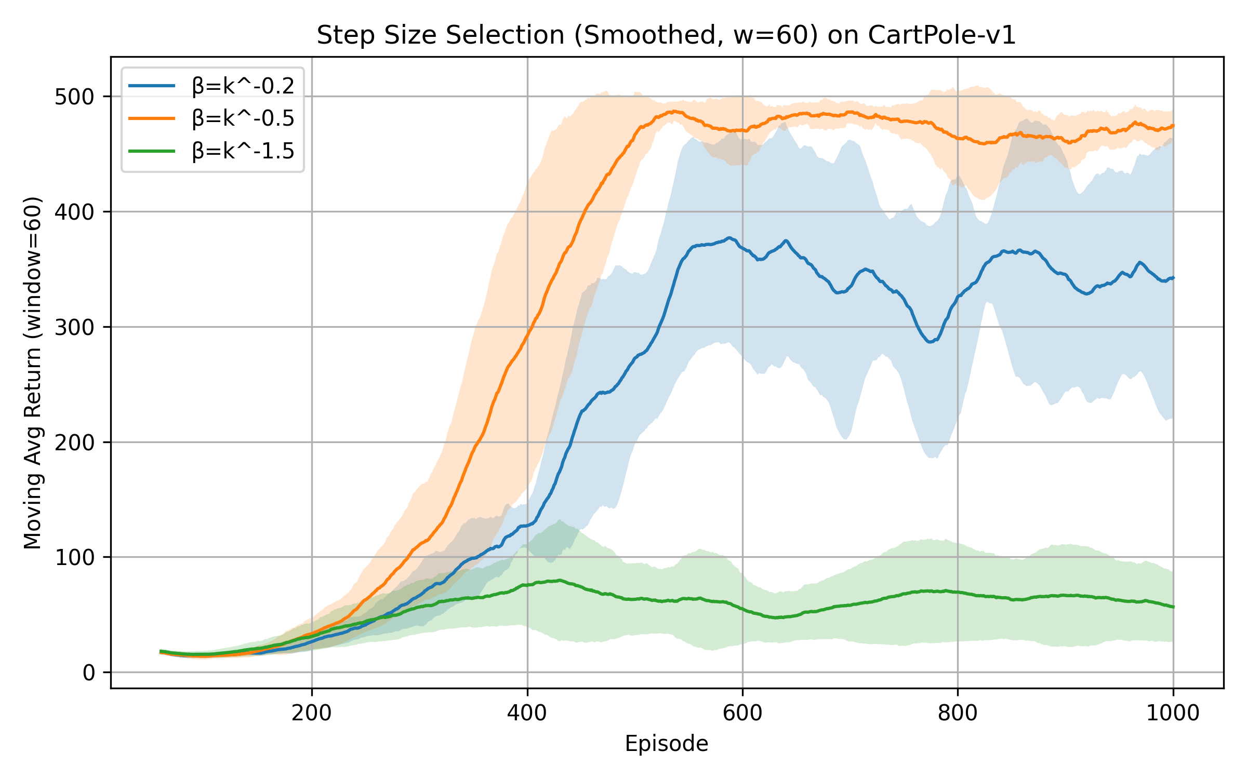
Cart Pole
We test three different step-size schedules.
Each schedule is run for 10 trials using different random seeds.
Evaluation Metric: Performance is measured by the total reward per episode. Learning curves show the mean and standard deviation across the 10 seeds. Optimal reward: 500.
We plot raw returns and moving average returns. The results matches our theoretical proof of step size selection.
Results:${ η}_{k} =k^{−1.5} \left(green\right) \text{leads} \text{to} \text{the} \text{failrue} \text{of} \text{convergence},{ η}_{k} =k^{−0.5} \left(orange\right) gets the global convergence,$
${ η}_{k}=k^{−0.2} \left(blue\right)$ causes global divergence.

Slide 31
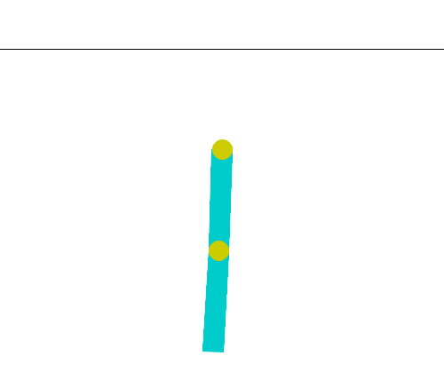
Acrobot
Action Space: 3 discrete actions
0: apply -1 torque to the actuated joint
1: apply 0 torque to the actuated joint
2: apply 1 torque to the actuated joint
Goal: apply torques on the actuated joint to swing the free end of the linear chain above a given height while starting from the initial state of hanging downwards.
Observation Space/State Space: 6 continuous variables
Num | Observation | Min | Max
0 | Cosine of theta1 | -1 | 1
1 | Sine of theta1 | -1 | 1
2 | Cosine of theta2 | -1 | 1
3 | Sine of theta2 | -1 | 1
4 | Angular velocity of theta1 | ~ -12.567 (-4 * pi) | ~ 12.567 (4 * pi)
5 | Angular velocity of theta2 | ~ -28.274 (-9 * pi) | ~ 28.274 (9 * pi)
https://gymnasium.farama.org/environments/classic_control/acrobot/
Rewards
The goal is to have the free end reach a designated target height in as few steps as possible, and as such all steps that do not reach the goal incur a reward of -1. Achieving the target height results in termination with a reward of 0. The reward threshold is -100.
Q network: 3 layers deep neural network
state dim (6) → hidden dim (64) → hidden dim (64) → action dim (3)

Slide 32
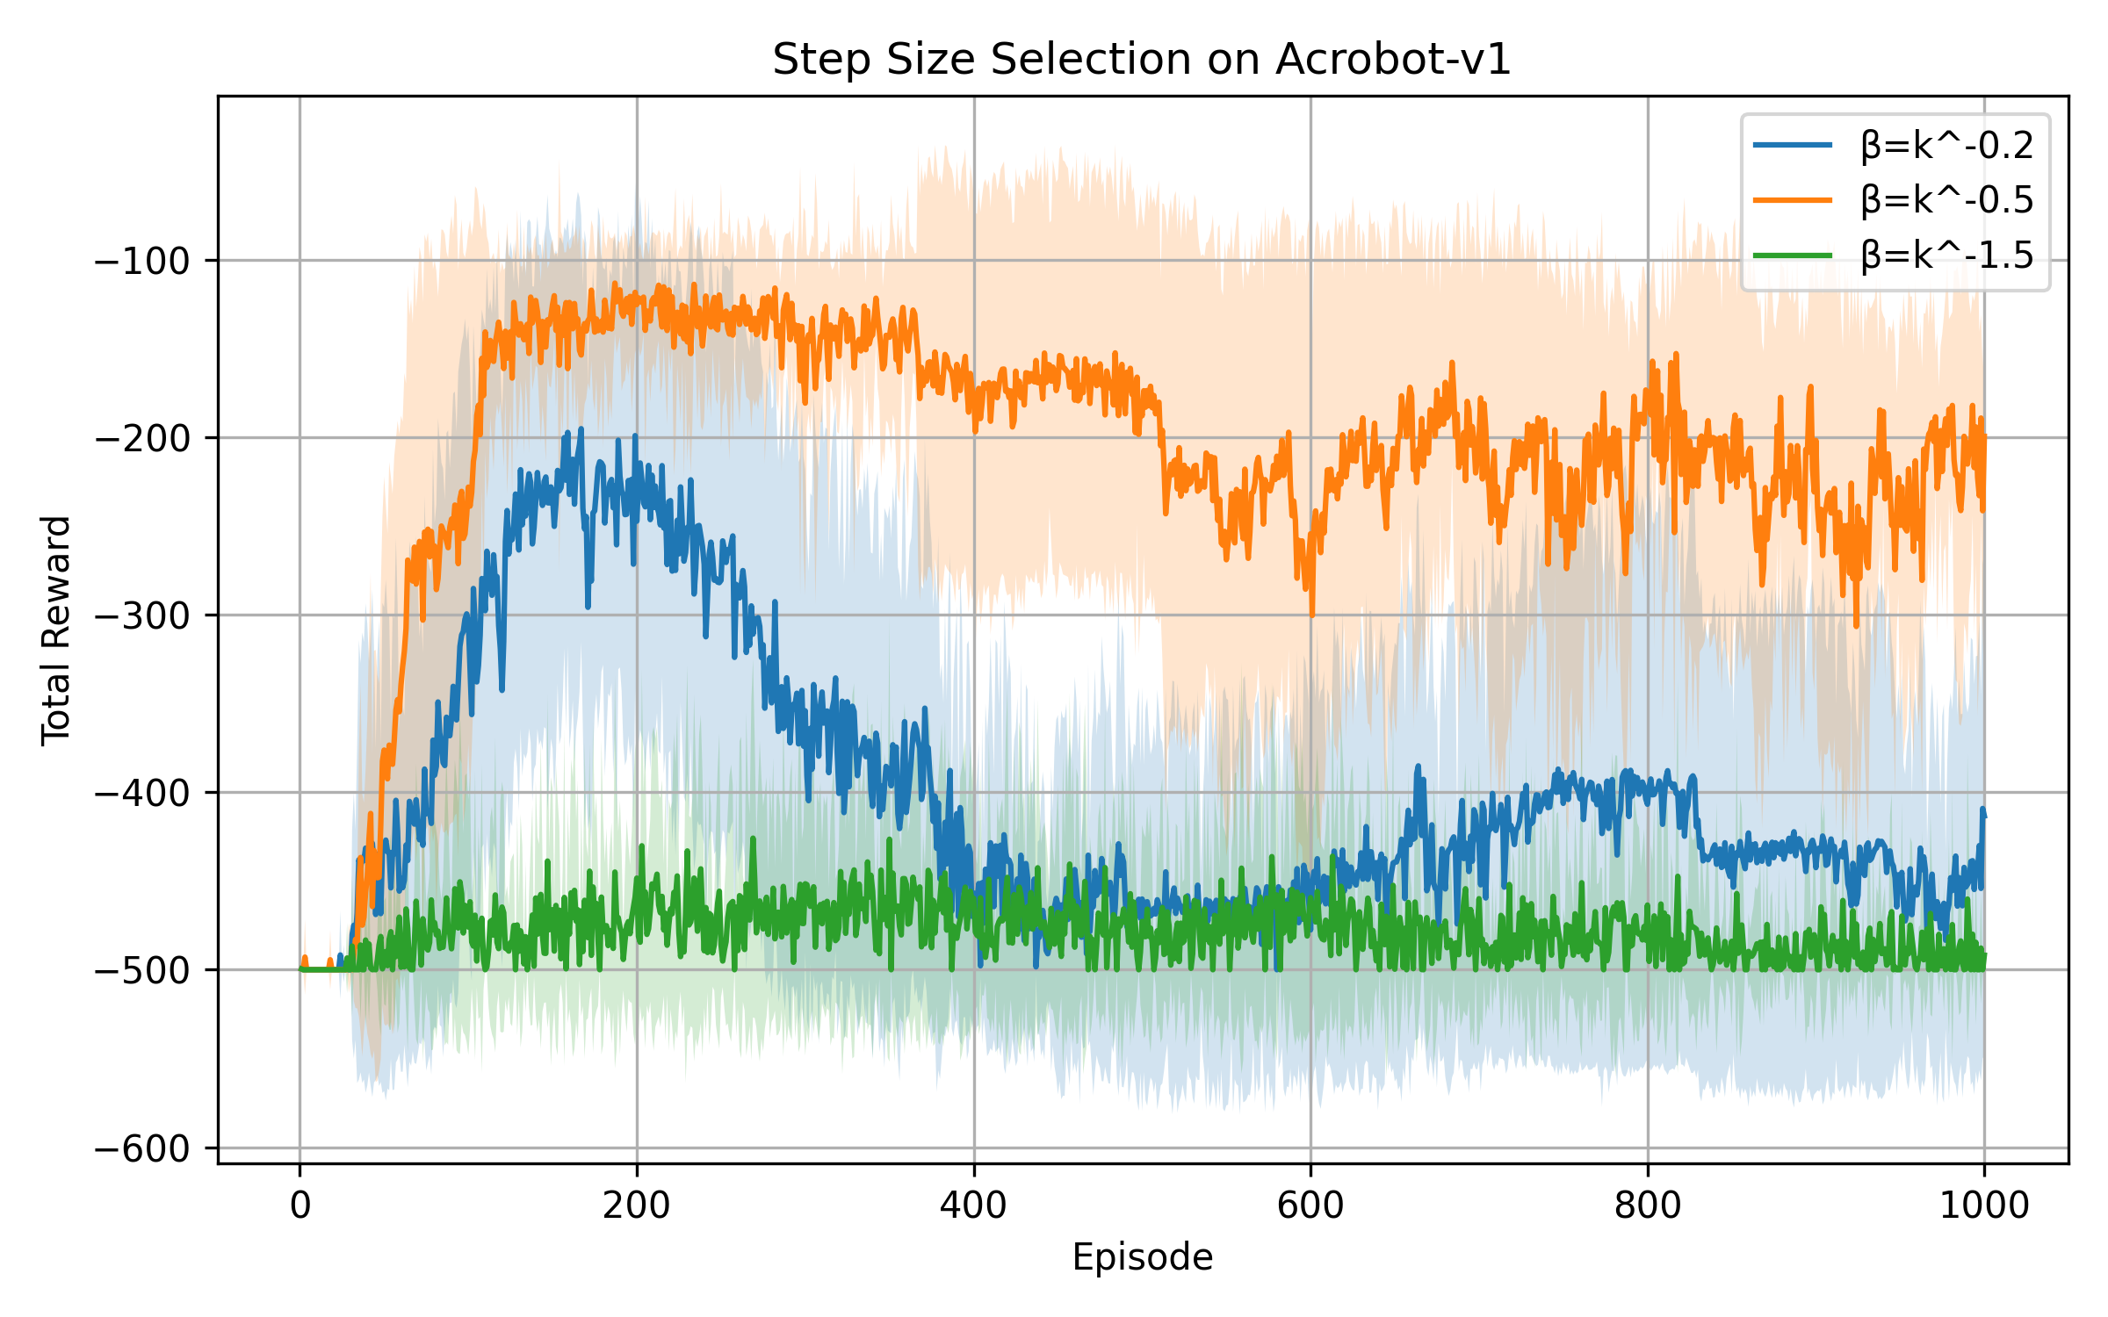
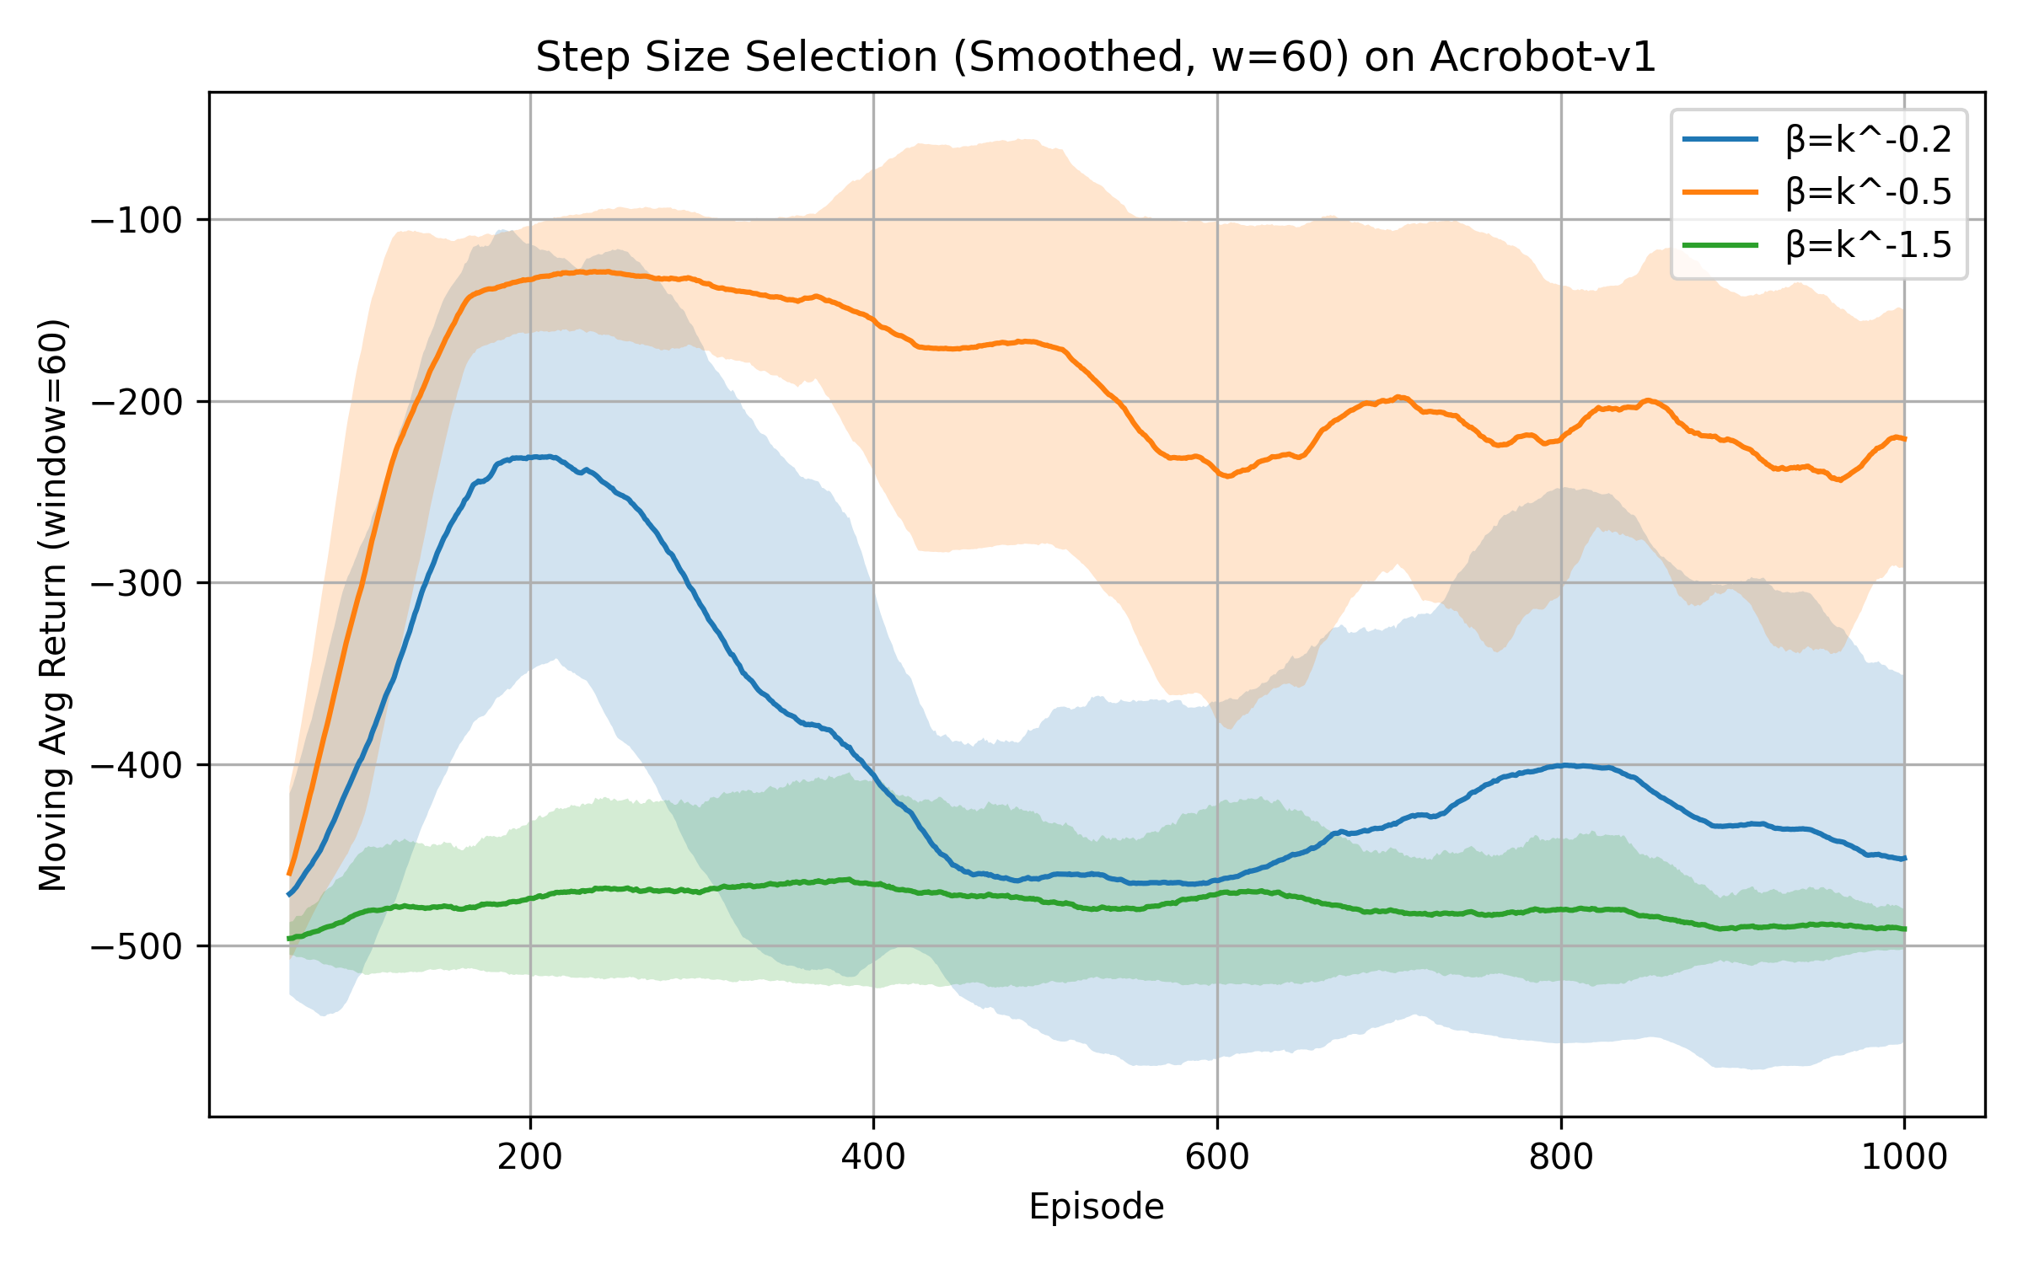
Acrobot
We test three different step-size schedules.
Each schedule is run for 10 trials using different random seeds.
Evaluation Metric: Performance is measured by the total reward per episode. Learning curves show the mean and standard deviation across the 10 seeds. Optimal reward: -100.
We plot raw returns and moving average returns. The results matches our theoretical proof of step size selection.
Results:${ η}_{k} =k^{−1.5} \left(green\right) \text{leads} \text{to} \text{the} \text{failrue} \text{of} \text{convergence},{ η}_{k} =k^{−0.5} \left(orange\right) gets the global convergence,$
${ η}_{k}=k^{−0.2} \left(blue\right)$ causes global divergence.

Slide 33
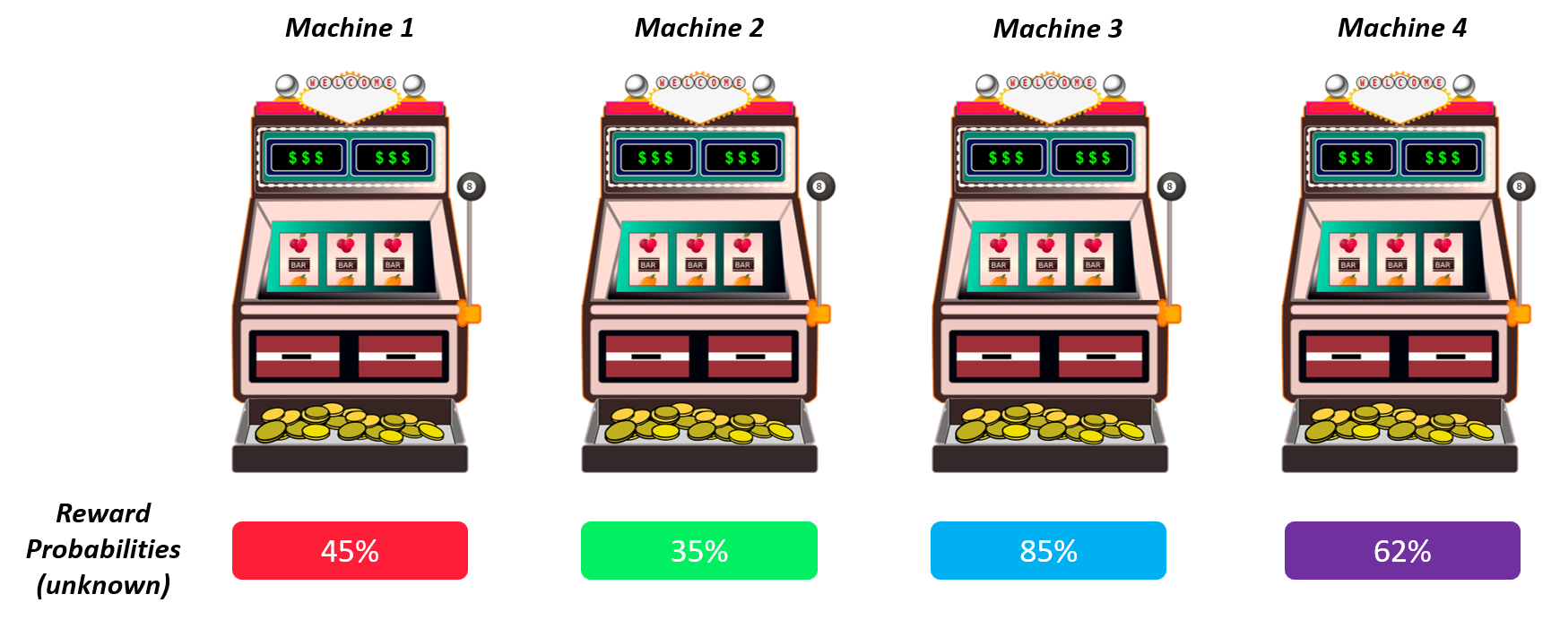
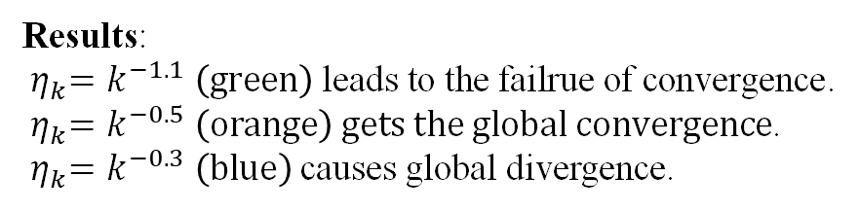
5-armed Bandit
Bernoulli Bandit Env:
The reward for pulling each lever follows a Bernoulli distribution. A reward of 1 means you win, and a reward of 0 means you don't win.
Dummy states with all 1s.
Results:
${ η}_{k}=k^{−1.1} \left(green\right)$ $\text{leads} \text{to} \text{the} \text{failrue} \text{of} \text{convergence}$.
${ η}_{k}=k^{−0.5} \left(orange\right)$ $gets the global convergence$.
${ η}_{k}=k^{−0.3} \left(blue\right)$ causes global divergence.
action == bandit_env.optimal_arm

Slide 34
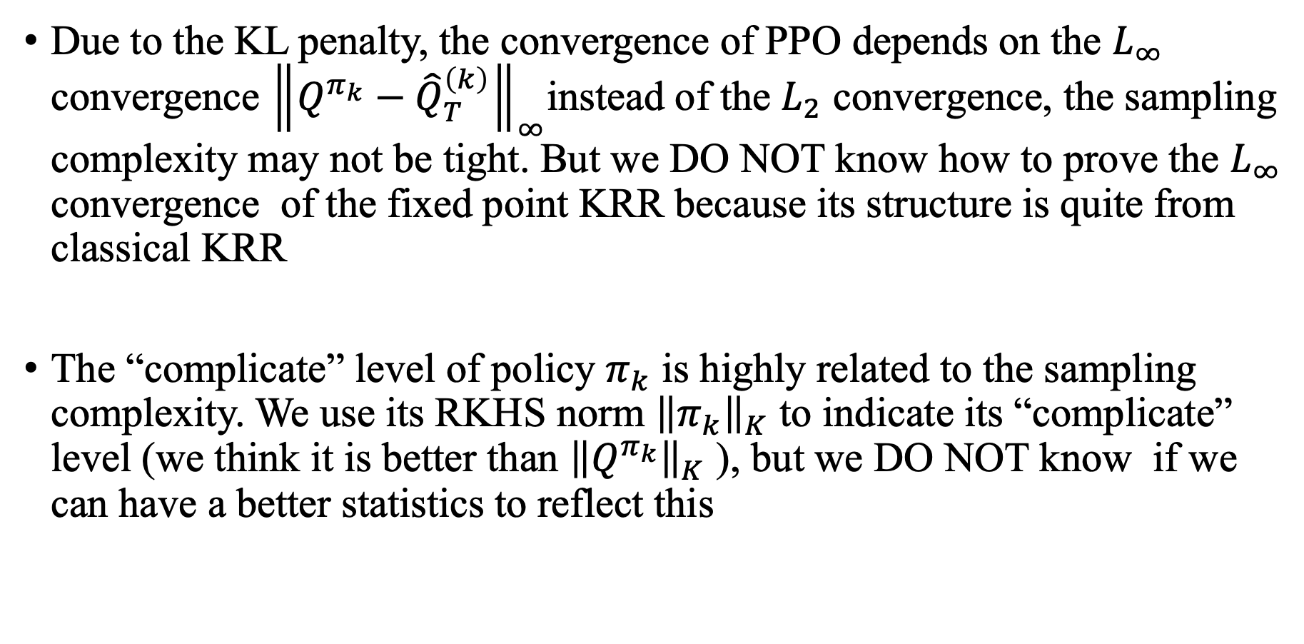
Theoretical Problems Unsolved
Due to the KL penalty, the convergence of PPO depends on the $L_{∞}$ convergence ${\left\|Q^{π_{k}}−{\hat{Q}}_{T}^{\left(k\right)}\right\|}_{∞}$instead of the $L_{2}$ convergence, the sampling complexity may not be tight. But we DO NOT know how to prove the $L_{∞}$ convergence of the fixed point KRR because its structure is quite from classical KRR
The “complicate” level of policy $π_{k}$ is highly related to the sampling complexity. We use its RKHS norm ${\left\|π_{k}\right\|}_{K}$ to indicate its “complicate” level (we think it is better than ${\left\|Q^{π_{k}}\right\|}_{K}$ ), but we DO NOT know if we can have a better statistics to reflect this

Slide 35
Thank you for your attention!
Any questions?

